Slide 1

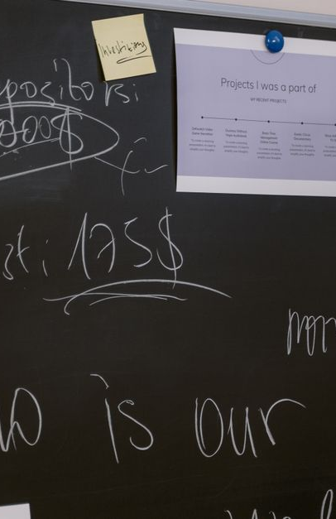
Project Kickoff Plan
Align on scope, success metrics, roadmap, and immediate next steps

Slide 2
TABLE
OF CONTENTS
01
Kickoff Cover
06
Team Structure and Roles
02
Purpose and Problem Statement
07
Ways of Working and Cadence
03
Scope and Core Deliverables
08
Immediate Next Steps and Day-1 Actions
04
Success Criteria and KPIs
05
Roadmap and Major Milestones

Slide 3
Kickoff Cover
Day-1 alignment intent
Program code traceability
Lead and sponsor contacts
Project name and clear intent for Day-1 alignment
Program code and operating context for traceability
Project lead and primary sponsor contacts
Kickoff date and location
Action plan promise
Launch date and kickoff meeting location or link
Template promise: action plan, shared success, next steps
Project Kickoff Plan
1

Slide 4
Purpose and Problem Statement
What changed and why
Business drivers
Customer impact
Background that explains what changed and why now
Business drivers: growth, cost, risk reduction, or compliance need
Customer impact: who benefits, what pain is removed, and measurable value
Agile framing
Sponsor decision criteria
Agile framing: outcomes first, assumptions surfaced early, learning cadence planned
Decision framing for sponsors: what must be true to proceed
Project Kickoff Plan
2

Slide 5
Scope and Core Deliverables
In-scope deliverables
Out-of-scope boundaries
VS
Prioritized epics, features, integrations, and capabilities that deliver the agreed outcomes
Items deferred, explicitly excluded, or requiring separate funding and change control
Project Kickoff Plan
3

Slide 6
Success Criteria and KPIs
Leader sign-off
Measurable KPIs
Baseline vs targets
Sign-off outcomes: what leaders approve as complete and usable
Measurable KPIs: adoption, quality, performance, cycle time, or cost targets
Baseline and targets: current state vs. desired future state with owners
Quality gates
KPI tracking
Quality gates: acceptance criteria, test coverage expectations, and risk thresholds
Tracking approach: dashboard source, review cadence, and escalation rules
Project Kickoff Plan
4

Slide 7
Roadmap and Major Milestones
Inception Alignment
Alpha Build & Feasibility
Beta Coverage & Readiness
General Availability Ops
Aligned vision, backlog shaping, and an initial risk register ready
Working increments, usability validation, and technical feasibility confirmed
End-to-end coverage, stakeholder acceptance rehearsed, and readiness review complete
Production readiness, operational handoff, and KPI monitoring live
Project Kickoff Plan
5

Slide 8
Team Structure and Roles
Advisory and stakeholders
Compliance, security, legal, and key business owners for reviews
Core delivery team
Product, engineering, design, data, QA, and operations responsibilities mapped
Program leadership
Program director and delivery lead manage scope, risks, and integration
Executive sponsors
Approve funding, remove blockers, and confirm strategic outcomes
Project Kickoff Plan
6

Slide 9
Ways of Working and Cadence
01
02
03
04
05
Sprint rhythm
Daily execution
Communication channels
Documentation hubs
Governance cadence
Define sprint length, planning agenda, demo format, and retrospective focus
Set standup time, attendance expectations, and a clear blocker escalation path
Use Slack channels by theme, with guidance on when to use each channel
Maintain a single source of truth for decisions, backlog, requirements, and releases
Run a weekly stakeholder sync and biweekly sponsor touchpoints
Project Kickoff Plan
7

Slide 10
Immediate Next Steps and Day-1 Actions
Day 0
Days 1-3
Days 4-7
Days 8-14
Kickoff deck publication
Scope, KPI baseline, and gates
Backlog, risks, and integration plan
Demo, sign-off, and reporting readiness
Finalize kickoff deck, confirm success criteria owners, and publish the working agreement
Lock scope boundaries, validate KPIs baseline, and confirm milestone gate dates
Create initial backlog, risk register, and integration plan with responsible teams
Rehearse demo and sign-off workflows, confirm reporting dashboards, and close open decisions
Project Kickoff Plan
8

