Slide 1

Transformation Through Contrast
A story framework to turn wounds into earned change and a clear moral

Slide 2
Table
of Contents
01
Spark That Pulls Them In
02
The Journey’s Starting Atmosphere
03
Inciting Friction Reveals the Wound
04
What They Believe vs What’s True
05
The Coach’s Question That Cuts
06
Character With a Private Need
07
Stake the Cost of Staying Still
08
Turning Point Arrives Like a Door
09
Discovery: The Method in One Beat
10
From Confusion to a Clear Sentence

Slide 3

Spark That Pulls Them In
Hook frame
Hook frame: a 3-word title overlay only; no bullets on this slide
Transformation Through Contrast
1

Slide 4

The Journey’s Starting Atmosphere
Comfort vs tension metaphor
Use a visual metaphor to name the world: comfort vs tension, calm vs storm
Transformation Through Contrast
2

Slide 5
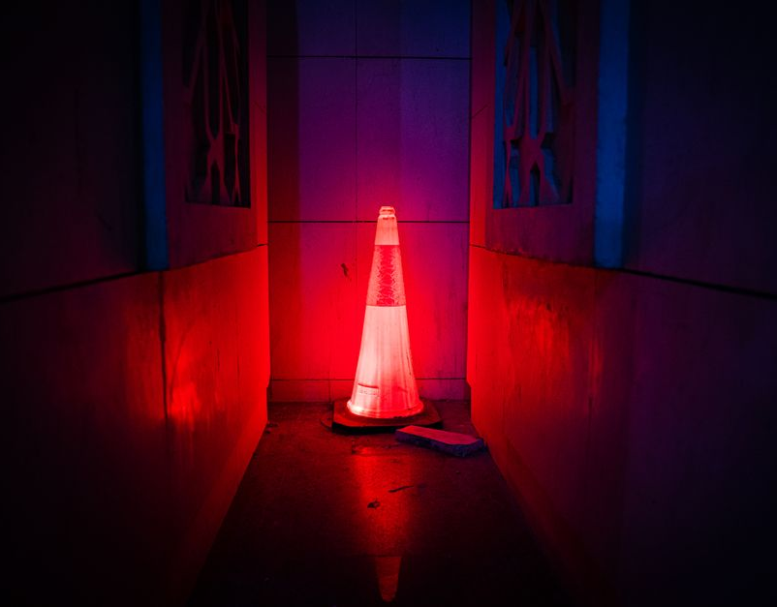
Inciting Friction Reveals the Wound
Provocative image moment
Show the core challenge as a single provocative image moment; keep text minimal
Transformation Through Contrast
3

Slide 6

What They Believe vs What’s True
Perception vs reality flip
Contrast perception with reality using a stark visual flip: mask to face, chart to chaos
Transformation Through Contrast
4

Slide 7

What would have to be true for this story to feel inevitable?
—
Transformation Through Contrast

Slide 8

Character With a Private Need
Single Human Detail
Frame the protagonist through a single human detail: hands, gaze, posture, or breath
Transformation Through Contrast
6

Slide 9

Stake the Cost of Staying Still
Stated Risk
Make the risk visible: what gets lost if nothing changes; one image, one emotional truth
Transformation Through Contrast
7

Slide 10

Turning Point Arrives Like a Door
Pivot Signaling
Use a dynamic frame to signal a pivot: threshold, switch, rupture, or rescue
Transformation Through Contrast
8

Slide 11

Discovery: The Method in One Beat
Visual coaching mechanic
Reveal the coaching move as a visual mechanic: lens shift, map redraw, switch in angle
Transformation Through Contrast
9

Slide 12

From Confusion to a Clear Sentence
Center Sentence
Compress the insight into a single center sentence; let the image do the heavy lifting
Transformation Through Contrast
10

