Slide 1
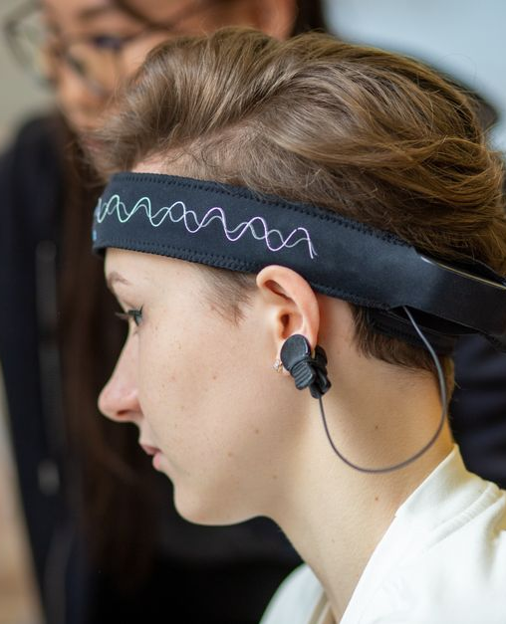
SIRIUS Neuroscience Study
A structured framework for studying neural mechanisms and translating findings

Slide 2
Table
of Contents
01
SIRIUS Neuroscience Study Template
02
Neurobiological Context and Relevance
03
Anatomical Targets and Pathways
04
Experimental Methodology Stack
05
Neural Activity and Electrophysiology
06
Behavioral Correlation and Results
07
Mechanism of Action and Model
08
Clinical Translations and Neurotherapeutics

Slide 3
SIRIUS Neuroscience Study Template
Study title and thesis
Author and institution
Date and series
Study title, neural domain, and a one-line research thesis for fast audience alignment
Author or lab name plus institution to anchor credibility and collaboration context
Date and symposium/lecture series label for consistent event branding across venues
Accent palette mapping
Study aims and metrics
Neon-cyan and violet accent palette mapped to neural signal and mechanistic emphasis
Replace placeholders with your study’s exact aims, hypotheses, and outcome metrics
SIRIUS Neuroscience Study
1

Slide 4
Neurobiological Context and Relevance
Circuit computation problem
Disease and symptom relevance
Neural signature distinction
Cellular and circuit-level problem statement: what computation or dysfunction the brain circuit performs
Neurological relevance: connect to disease mechanism, symptom dimensions, or neural computation deficits
Core biological question: identify the measurable neural signature that distinguishes normal vs pathological states
Predicted neural changes
Causal design controls
Hypothesis framing: expected directionality for firing, synchrony, oscillations, or plasticity markers
Design constraints: what must be controlled (state, stimulus, motion, sampling bias) to claim causality
SIRIUS Neuroscience Study
2

Slide 5
Anatomical Targets and Pathways
Pathway coordinates
Show afferent/efferent links and label recording/stimulation coordinates
Striatum role
State action selection or habit circuitry role and the downstream pathway to motor or cognitive output
Hippocampal contribution
Specify memory/sequence contribution and the projection route linking to cortical dynamics
Cortical computation
Define the cortical computation and layer-level target for the primary recording or stimulation site
SIRIUS Neuroscience Study
3

Slide 6
Experimental Methodology Stack
01
03
05
02
04
Model and controls
Perturbation delivery
Preprocessing and QC
Neural data acquisition
Behavioral paradigm
Subject selection, baseline state, counterbalancing, and exclusion criteria are prepared as model and controls
Stimulation parameters, light wavelengths, patch-clamp protocols, and timing relative to task events are used to deliver perturbations
Motion correction, spike sorting, filtering, artifact rejection, and a blinded analysis plan are applied during preprocessing and quality-checking
Choose fMRI, patch-clamp, optogenetics, and define sampling rate, resolution, and targets for acquiring neural data
Specify task design, metrics, and synchronization to neural timestamps when running the behavioral or stimulus paradigm
SIRIUS Neuroscience Study
4

Slide 7
Neural Activity and Electrophysiology
Condition-linked latency
Response latency decreases across conditions, from 48.0 ms at Baseline to 29.0 ms under Perturb, indicating condition-linked neural timing changes.
SIRIUS Neuroscience Study
5

Slide 8
Behavioral Correlation and Results
Neural-to-behavior correlation
Effect size and robustness
VS
Correlate spike timing, oscillatory power, or fMRI activation with accuracy, reaction time, or error type
Show effect size and directionality plus robustness checks to support a mechanistic interpretation
SIRIUS Neuroscience Study
6

Slide 9
Mechanism of Action and Model
Pathway activation
01
Pathway activation drives synaptic state changes at the targeted circuit nodes
04
01
Recurrent computation
02
Recurrent dynamics reshape firing rates, synchrony, and phase relationships
Synaptic plasticity
03
Activity-dependent learning rules adjust weights or excitability across sessions
03
Behavioral output
02
04
Updated circuit state produces observable phenotype changes in the task
SIRIUS Neuroscience Study
7

Slide 10
Clinical Translations and Neurotherapeutics
Therapeutic implications
Neurotechnology roadmap
Future targets
Citations and evidence
Map the identified mechanism to targetable nodes (receptors, pathways, stimulation sites)
Propose biomarkers, closed-loop readouts, and intervention modality fit for translation
Specify next experiments that validate causality and improve generalization across cohorts
Include key prior studies and your strongest supportive results
SIRIUS Neuroscience Study
8

