Slide 1
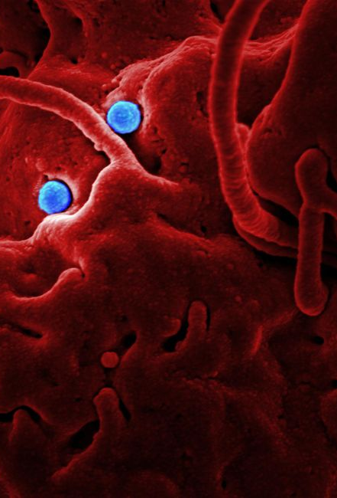

Pathogen Enrichment Report
Summarizes morphology, growth, virulence, resistance, and genetic findings

Slide 2
01
Pathogen Report Cover Sheet
02
Taxonomy and Microscopic Morphology
03
Culturing and Growth Kinetics
04
Pathogenicity and Virulence Factors
05
Antimicrobial Susceptibility Results
06
Genetic Profiling and PCR Analysis
07
Clinical or Environmental Manifestation
08
Therapeutic Countermeasures and Future Work

Slide 3
Pathogen Report Cover Sheet
Pathogen name and strain
Laboratory and biosafety
Investigator and contacts
Report date and version
include isolate code, source label, and lab accession reference
name, biosafety level, and internal review committee or project code
lead researcher, supervising PI, and corresponding author designation
specimen collection date, assay run date, and document revision tag
Pathogen Enrichment Report
1

Slide 4
Taxonomy and Microscopic Morphology
Gram status
Cellular shape
Gram reaction, cell envelope notes, and staining reproducibility
Rods/cocci/spirals, clustering pattern, and microcolony description
Motility and flagella
Microscopic profile
Presence/absence, polar vs peritrichous pattern, and microscopy method used
Key observations from light/fluorescence microscopy and imaging settings
Pathogen Enrichment Report
2

Slide 5
Culturing and Growth Kinetics
01
02
03
04
Agar media setup
Incubation conditions
Growth kinetics run
Growth curve chart
Specify base medium, supplements, selective agents, and expected colony morphology cues
Set temperature, atmosphere (aerobic/anaerobic/CO2), humidity, and time windows
Use a sampling schedule, choose an OD or CFU measurement approach, and define replicate structure
Lag-log-stationary phases placeholder with axes and units
Pathogen Enrichment Report
3

Slide 6
Pathogenicity and Virulence Factors
Toxin evidence
Host evasion
Biofilm pathway
Virulence factors
Assay type, detection threshold, and toxin gene or protein evidence for toxin production and secretion
Complement resistance, immune modulation, and barrier penetration indicators for host evasion mechanisms
Surface attachment, EPS matrix build-up, maturation, and dispersal pathway for biofilm formation
Ranked list of factors linked to observed phenotype or prior literature
Pathogen Enrichment Report
4

Slide 7
Antimicrobial Susceptibility Results
Antibiotic | MIC (Resistant) | MIC (Sensitive) | Interpretation | Method Notes
Antibiotic A | Resistant MIC value | Sensitive MIC value | Resistant/Sensitive | Disk diffusion or broth method
Antibiotic B | Resistant MIC value | Sensitive MIC value | Resistant/Sensitive | Incubation and reading criteria
Antibiotic C | Resistant MIC value | Sensitive MIC value | Resistant/Sensitive | Quality control strain reference
Pathogen Enrichment Report
5

Slide 8
Genetic Profiling and PCR Analysis
Gel electrophoresis
PCR targets and primers
Lane map, expected band sizes, ladder type, and run conditions
Gene names, amplicon size, cycling parameters, and controls
Genomic sequencing markers
Genotype-to-phenotype linkage
Variant calling highlights, MLST or core genome markers, and QC metrics
Link genotype markers to phenotype, resistance determinants, and virulence loci
Pathogen Enrichment Report
6

Slide 9
Clinical or Environmental Manifestation
Clinical manifestation
VS
Environmental role
Host interaction profile, symptom set, severity markers, and relevant specimen types
Survival niche, transmission route, bioavailability constraints, and persistence traits
Pathogen Enrichment Report
7

Slide 10
Therapeutic Countermeasures and Future Work
Antibiotic protocols
Vaccine and targets
Future research plan
Citations and evidence links
Recommended regimen template, dosing considerations, and monitoring endpoints
Antigen candidates, immune correlates, and rationale from virulence loci
Follow-up experiments for mechanisms, resistance evolution, and assay refinement
Key studies supporting findings and methodological standards
Pathogen Enrichment Report
8

