Slide 1
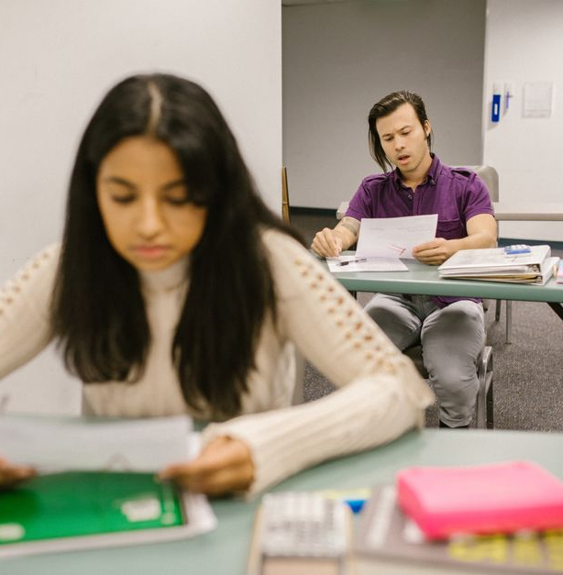
Grade-Level Classroom Overview
A teacher introduction and guide to curriculum, routines, and communication

Slide 2
Table
of Contents
01
Welcome to [Grade/Subject]!
02
About Me
03
Classroom Philosophy & Values
04
Curriculum Highlights & Goals
05
Daily Schedule & Important Dates
06
Communication & How to Help

Slide 3
Welcome to [Grade/Subject]!
Welcome message
Teacher and classroom
Back-to-school orientation
Welcome to our classroom! I’m excited to meet you and help you learn, grow, and feel confident this year.
[Teacher Name], [Role] — Room [Number]. I’m here to support every student and partner with families throughout the year.
We’re kicking off the year with a quick orientation to help families and students get started strong.
Today’s expectations
Scrapbook-style photo
Today we’ll go over what to expect, where to find key classroom information, and how we’ll start the year together.
Look for a friendly photo in our scrapbook-style frame—let’s capture our first moments in class!
Grade-Level Classroom Overview
1

Slide 4
About Me
Teaching approach
Credentials
Years teaching
I teach by making lessons clear, engaging, and student-centered. My focus is building strong foundational skills while encouraging curiosity, confidence, and respectful collaboration.
My education and professional training support my classroom work, from subject knowledge to effective instructional strategies. These credentials help ensure I plan with purpose and deliver with consistency.
I’ve taught for several years, and each year has shaped how I support learners. Students’ questions and progress have taught me what works best in the classroom.
Family connections
Personal detail
In my free time, I enjoy hobbies that help me connect with students and families. These interests keep me energized and let me relate to what matters outside of school.
I have a pet or family detail that makes me feel more grounded and approachable. Sharing it helps students see me as real and builds warmer classroom relationships.
Grade-Level Classroom Overview
2

Slide 5
Classroom Philosophy & Values
Classroom expectations
Simple routines for learning and behavior
Mutual respect
Kind choices, clear boundaries, and shared accountability
Safety and belonging
Students feel seen, heard, and supported
Growth mindset
Effort, practice, and reflection come first
Grade-Level Classroom Overview
3

Slide 6
Curriculum Highlights & Goals
Subject | Quarter Focus | Learning Goals
Reading | Comprehension and skills | Build vocabulary, fluency, and understanding
Math | Concepts and problem solving | Reason, model, and master grade-level skills
Science | Inquiry and investigations | Ask questions, observe patterns, and explain
Social Studies | Community and civics | Connect history and culture to real life
Grade-Level Classroom Overview
4

Slide 7
Daily Schedule & Important Dates
01
02
03
04
Morning arrival routine
Learning blocks
Afternoon wrap-up
Important dates
Students arrive and go to the designated area, then begin the first activity right away
Learning time follows a set sequence: reading, math, science, and social studies
After school, students complete a quick review, reflect on the day, and follow homework expectations
Upcoming tests, field trips, and holiday breaks are scheduled on specific dates
Grade-Level Classroom Overview
5

Slide 8
Communication & How to Help
Email for questions, updates, and scheduling needs
Email support
Classroom messaging app for quick reminders and alerts
Messaging app
Scan QR code to join the class channel fast
Class channel QR
Volunteer sign-up and at-home supports aligned to learning goals
Volunteer & at-home support
Grade-Level Classroom Overview
6

