Slide 1


Annual Marketing Strategy
Aligns objectives, positioning, channels, and forecasts into a 12-month plan

Slide 2
Table
of Contents
01
Annual Marketing Strategy Cover
02
Executive Summary and Strategic Objectives
03
Market Dynamics and Category Trends
04
Target Audience and Segmentation
05
Strategic Brand Positioning
06
Integrated Growth Engines
07
Budget Distribution and Channel Modeling
08
Revenue Forecast and Unit Economics
09
12-Month Execution Roadmap

Slide 3
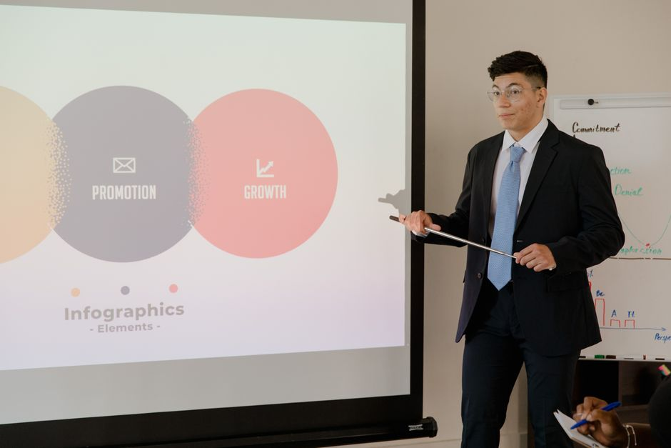
Annual Marketing Strategy Cover
Board approval strategy
Brand identity baseline
Fiscal year cadence
For board approval, this strategy is built for clear investment decisions
Insert brand identity and the current positioning baseline
Insert planning horizon and governance cadence
CMO details
SIRIUS template
Insert CMO name, title, and reporting line
Use the SIRIUS modern leadership design with sapphire and tangerine accents
Annual Marketing Strategy
1

Slide 4

Executive Summary and Strategic Objectives
Revenue pipeline
Market expansion
Brand growth outcomes
Define net-new pipeline and sourced revenue contribution by stage
Prioritize regions, segments, and partner channels with highest upside
Align brand growth to demand creation, conversion, and retention outcomes
Funding and milestones
Success metrics
Specify funding envelope, expected performance window, and decision milestones
Pipeline velocity, conversion rates, CAC efficiency, and brand health indicators
Annual Marketing Strategy
2

Slide 5

Market Dynamics and Category Trends
Macro demand drivers
Customer buying behavior
Category unmet needs
Demand drivers, budget shifts, and buyer urgency themes create macro opportunities
Changes across channels, buying criteria, and evaluation behavior show a customer shift
Unmet needs, weak messaging areas, and underserved subsegments reveal category gaps
Competitive underinvestment
Board takeaway
Incumbents underinvest in specific areas while differentiation opportunities remain open
This category is compelling now, and the approach is positioned to win
Annual Marketing Strategy
3

Slide 6

Target Audience and Segmentation
ICP matrix
Behavioral triggers
Decision drivers
Firmographics that reflect ideal buyer size, industry, and operating model
Engagement signals that indicate intent and timing readiness
Economic buyer priorities, technical requirements, and risk concerns
Segmentation cards
Qualification logic
Tailor messaging, offers, and channels per segment archetype
Lead scoring signals that connect marketing to sales outcomes
Annual Marketing Strategy
4

Slide 7
Strategic Brand Positioning
Messaging architecture
Align headlines, proof points, and CTAs across funnel stages
Brand narrative
Connect proof, customer language, and emotional resonance to the value story
Core value proposition
Articulate measurable outcomes and the mechanism that delivers them
Category positioning
Claim the most credible space with clear differentiation and relevance
Annual Marketing Strategy
5

Slide 8
Integrated Growth Engines
Brand awareness
Raise category salience with high-reach messaging and distinctive creative
Inbound content
Capture intent with problem-led assets, thought leadership, and conversion paths
Scale qualified demand using audience targeting, creative testing, and landing optimization
Paid performance
Connect nurture sequences to sales handoff with feedback-based refinement
Conversion loop
Annual Marketing Strategy
6

Slide 9
Budget Distribution and Channel Modeling
Budget Line | Programs | Software | Headcount
Demand creation | Core campaigns | Marketing automation | Lifecycle marketers
Brand building | Creative + media | Design systems | Brand strategist
Conversion optimization | CRO experiments | Analytics + testing | Performance analyst
Enablement | Sales collateral | CRM enrichment | Marketing ops support
Annual Marketing Strategy
7

Slide 10
Revenue Forecast and Unit Economics
Unit economics trajectory
Demand-to-revenue model rates rise from 0.18 in Month 1 to 0.30 by Month 12, while the blended CAC index improves from 110.0 to 92.0 over the same planning horizon
Annual Marketing Strategy
8

Slide 11
12-Month Execution Roadmap
Q1 Plan launch
Q2 Campaign scale
Q3 Pipeline acceleration
Q4 Efficiency gains
Positioning and ICP
Omnichannel deployment
Paid and enablement optimization
Unit economics improvement
Finalize positioning, ICP messaging, and measurement foundations
Deploy omnichannel programs with creative testing and inbound conversion upgrades
Optimize paid performance, nurture, and sales enablement handoffs
Improve unit economics via CRO, attribution tuning, and strategic reallocation
Annual Marketing Strategy
9

