Slide 1
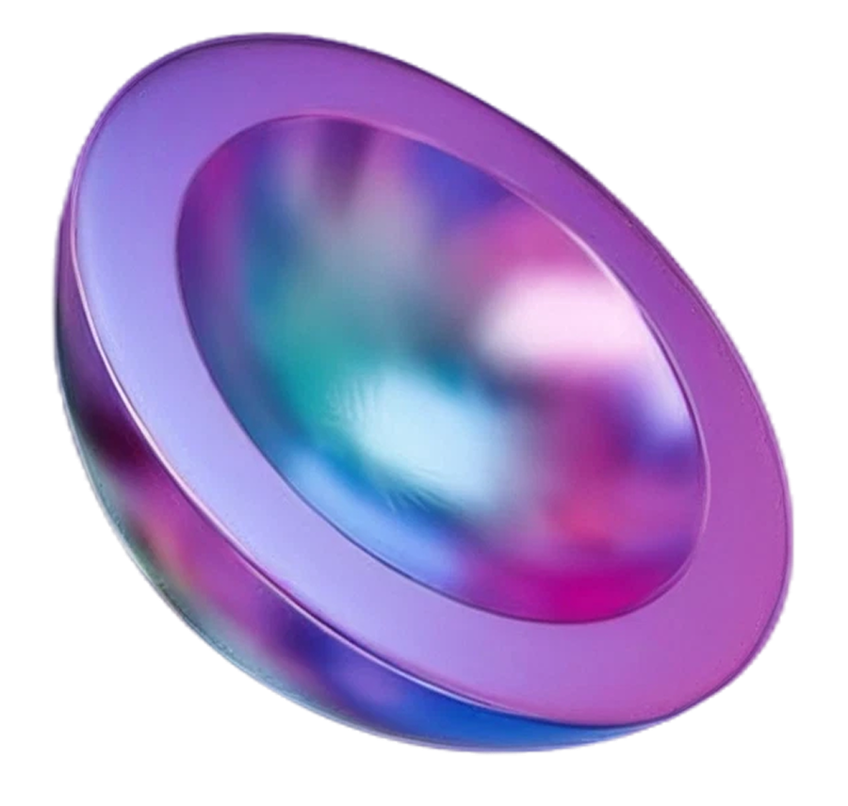
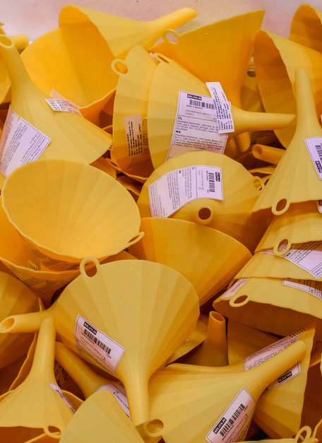
Full-Funnel Campaign Growth
A KPI-driven plan to optimize creative, targeting, spend, and scaling

Slide 2
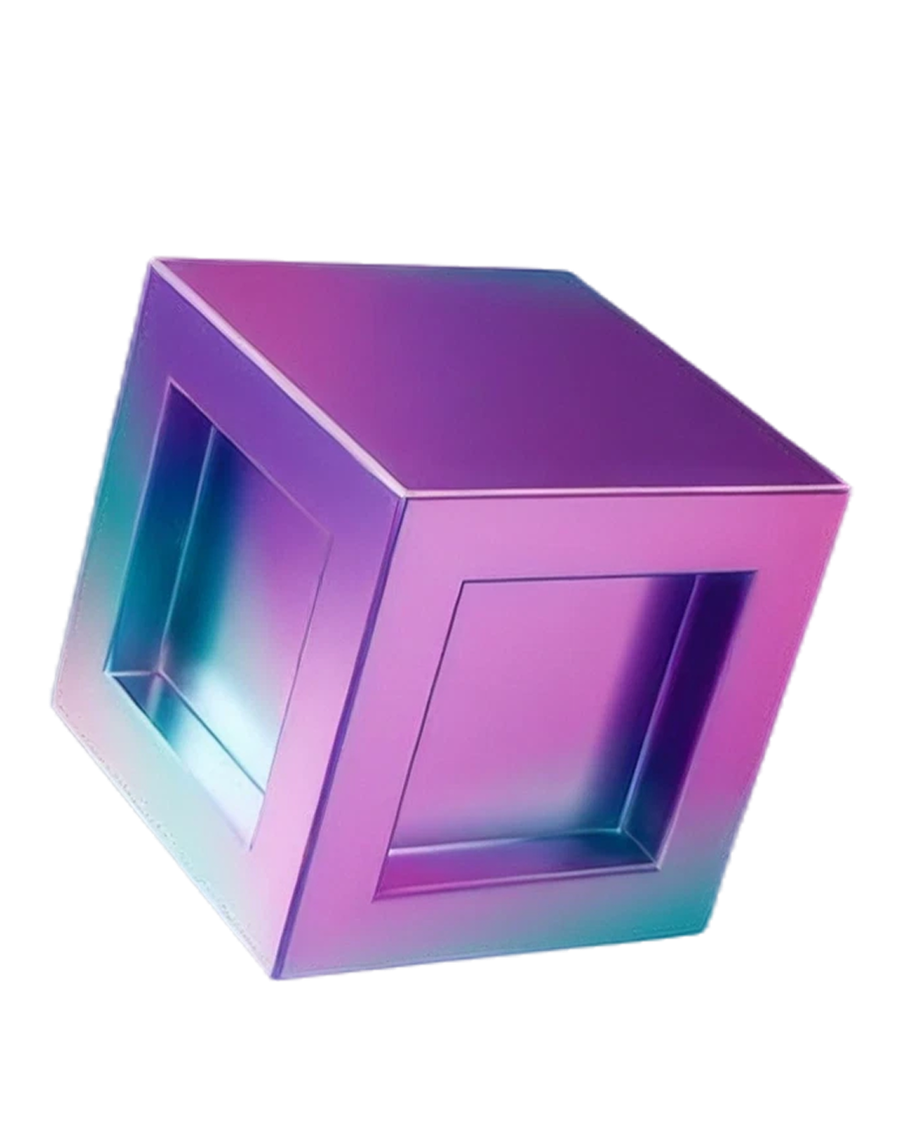
Table
of Contents
01
Campaign Pitch Overview
02
Performance Scorecard KPIs
03
Full-Funnel Growth Architecture
04
Channel Performance Breakdown Table
05
Creative Teardown and Ad Metrics
06
Audience Segmentation and Retargeting
07
Media Spend Allocation and Returns
08
Scaling Roadmap and Test Sprints

Slide 3
Campaign Pitch Overview
Campaign goals & targeting
Growth horizon
Prepared by team
Goals, offer, markets, and target customer
Timeframe for performance targets and learning milestones
Growth Marketing Team with roles for strategy, media, and analytics
Meeting purpose
Decision asks
Align on KPIs, channel plan, and expected outcomes
Approve budget direction, creative priorities, and test plan
Full-Funnel Campaign Growth
1

Slide 4
Performance Scorecard KPIs
Blended CAC
ROAS
Conversion Rate
Customer LTV
Cost per acquired customer across all channels
Revenue efficiency versus media spend
Funnel completion rate from traffic to purchase/lead
Projected customer value driving payback and scaling
Full-Funnel Campaign Growth
2

Slide 5
Full-Funnel Growth Architecture
Bottom-of-Funnel Conversion
Conversion focus via landing page testing, offer refinement, and cart or lead capture
Middle-of-Funnel Nurture
Nurture through retargeting, email sequences, and content that builds consideration
Top-of-Funnel Prospecting
Prospecting with paid search and social, broad audiences, and high-intent keywords
Full-Funnel Campaign Growth
3

Slide 6
Channel Performance Breakdown Table
Channel | Spend | Efficiency | Conversions | LTV Impact
Paid Search | Planned vs actual | ROAS / CPA | Leads or purchases | Attributed value
Paid Social | Planned vs actual | ROAS / CPA | Clicks to conversions | Incremental lift
SEO | Planned vs actual | Cost per qualified visit | Organic conversions | Long-term value
Email | Planned vs actual | Open to conversion rate | Revenue per send | Retention contribution
Full-Funnel Campaign Growth
4

Slide 7
Creative Teardown and Ad Metrics
Creative frame mix
CTR and CPA signals
Hook, offer, proof, CTA, and landing page alignment
CTR and CPA highlight winners and cost drivers
Creative hypothesis
One-variable iteration
Why the asset works and which audience segment it attracts
Swap one variable at a time to isolate impact, including headline, image, and CTA
Full-Funnel Campaign Growth
5

Slide 8
Audience Segmentation and Retargeting
Define cohorts by intent and recency, including new visitors, engaged users, and cart or lead actions
Intent and recency cohorts
Activate retargeting based on site events and lifecycle stages using custom triggers
Custom event triggers
Tailor messaging to the funnel stage and predicted conversion likelihood for personalization
Funnel-stage personalization
Track cohort ROAS, CPA, and downstream LTV to avoid short-term bias in measurement
Cohort ROAS and LTV
Full-Funnel Campaign Growth
6

Slide 9
Media Spend Allocation and Returns
Channel Spend Mix
Channel spend mix shows Paid Search at 35%, Paid Social at 30%, SEO at 20%, and Email at 15%—with Paid Search taking the largest share and Email the smallest
Full-Funnel Campaign Growth
7

Slide 10
Scaling Roadmap and Test Sprints
01
03
02
04
Weekly optimization loop
Sprint execution
Experimental backlog
Scaling decision
Monitor KPIs, diagnose variance, and adjust bids, budgets, and targeting
Define hypothesis, success metrics, and stopping rules for each experiment
Queue tests across creative, landing pages, offers, and audience cohorts
Promote winners, pause losers, and roll learnings into the next sprint
Full-Funnel Campaign Growth
8

