Slide 1

Comprehensive Competitor Analysis and Strategic Positioning
Evaluating Market Landscape, Competitor Profiles, and Tactical Responses for Competitive Advantage

Slide 2
Table of Contents
Competitor Analysis Report
Market Landscape Overview
Competitor Capability Matrix
Strategic Positioning Map
Deep Dive: Key Competitor Profile
Pricing & Go-To-Market Comparison
SWOT Comparison: Our Company vs. Top Competitor
Strategic Opportunities & Counter-Tactics
03
04
05
06
07
08
09
10

Slide 3

Competitor Analysis Report
Market sector and scope for the rival evaluation
Prepared by Intelligence Team with ownership for updates
Report date and version for audit-ready tracking
Market sector and scope for the rival evaluation
Prepared by Intelligence Team with ownership for updates
Report date and version for audit-ready tracking
Comprehensive Competitor Analysis and Strategic Positioning
3

Slide 4
Market Landscape Overview
Total Addressable Market Map
Primary Competitors Analysis
Secondary and Emerging Competitors
Total addressable market map segmented by customer needs and use cases
Primary competitors mapped to the core buyer journey and highest-intent segments
Secondary and emerging competitors tracked by innovation signals and distribution momentum
Comprehensive Competitor Analysis and Strategic Positioning
4

Slide 5
Competitor Capability Matrix
Competitor | Feature Set | Pricing | Market Share | Target Audience
Rival A | High coverage | Mid-to-premium | Leader | Enterprise buyers
Rival B | Moderate coverage | Value tiers | Challenger | SMB and teams
Rival C | Niche strengths | Premium add-ons | Emerging | Specialized workflows
Comprehensive Competitor Analysis and Strategic Positioning
5

Slide 6
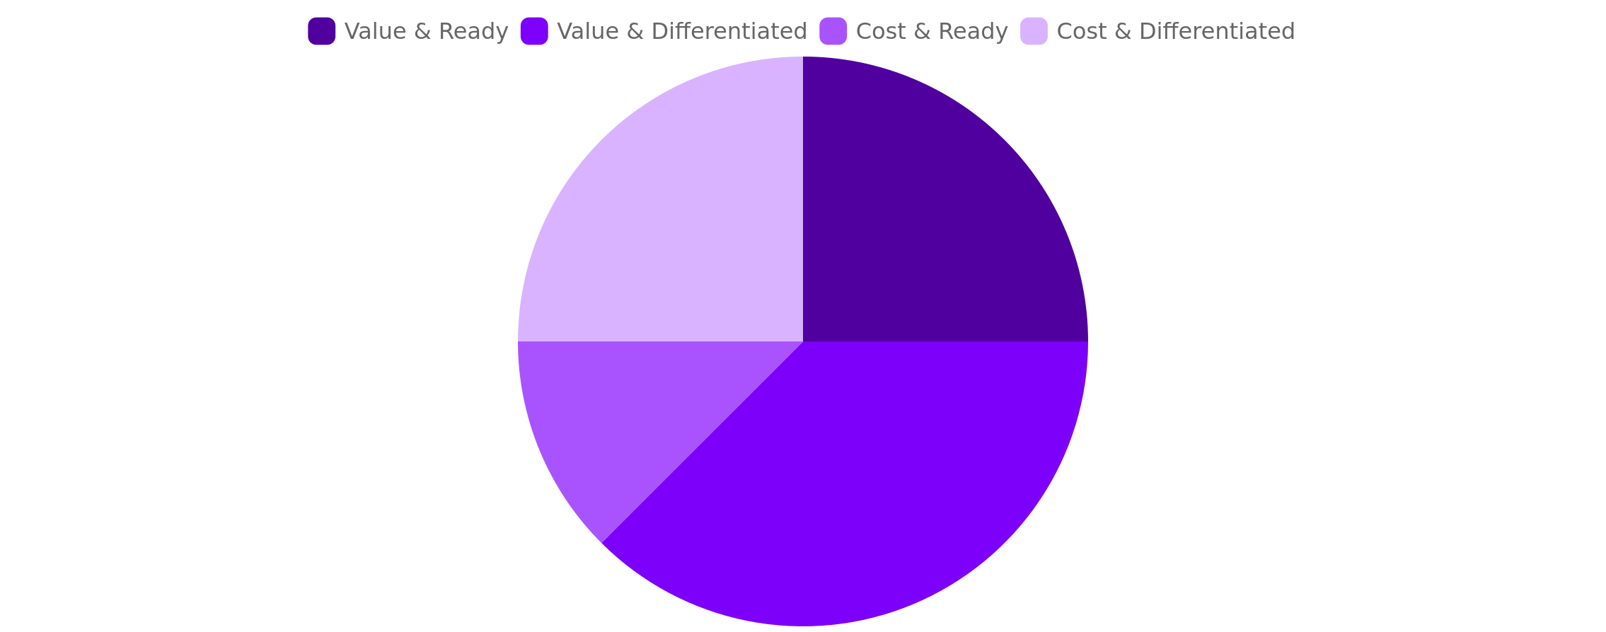
Strategic Positioning Map
Comprehensive Competitor Analysis and Strategic Positioning
6

Slide 7
Deep Dive: Key Competitor Profile
Strengths
Weaknesses
Business model
product moat
distribution advantage
customer retention drivers
gaps in features
service constraints
adoption friction points
revenue streams
packaging strategy
partnership dependencies
Comprehensive Competitor Analysis and Strategic Positioning
7

Slide 8
Pricing & Go-To-Market Comparison
Competitor | Pricing Tiers | Acquisition Channels | Promotions
Rival A | 3 tiers, annual incentives | Direct sales, partners | Free onboarding, case-study ads
Rival B | 2 tiers, monthly-first | Self-serve, marketplaces | Trial discounts, comparison pages
Rival C | Premium add-ons | Channel resellers, communities | Limited-time bundles, webinar series
Comprehensive Competitor Analysis and Strategic Positioning
8

Slide 9
SWOT Comparison: Our Company vs. Top Competitor
Strengths and Weaknesses
Opportunities
Threats
Strengths and weaknesses contrasted across product, operations, and customer experience
Opportunities identified from market gaps, segments to capture, and channel expansion routes
Threats assessed for competitive pressure, pricing risk, and switching-cost dynamics
Comprehensive Competitor Analysis and Strategic Positioning
9

Slide 10

Strategic Opportunities & Counter-Tactics
Prioritize Moves
Counter-tactics
Execution Plan
Prioritize moves that close benchmark gaps while defending the highest-value segments
Respond to rival pricing and messaging with differentiated value proof
Assign owners, define leading indicators, and set review cadence for iteration
Comprehensive Competitor Analysis and Strategic Positioning
10

