Slide 1

Quarterly Executive Business Review: Performance, Impact, and Strategic Partnership
Comprehensive Analysis of Business Outcomes, Adoption Trends, Risk Management, and Future Growth Plans

Slide 2
Quarterly Executive Business Review: Performance, Impact, and Strategic Partnership
2
Executive Business Review
Client and Company Details
Review Period
Account Team
Client: Client Name
Company: Company Name
Review period: Date (Quarterly Business Review)
Account team: Executive sponsor, Customer Success Manager, Solutions Engineer, Support lead

Slide 3
Quarterly Executive Business Review: Performance, Impact, and Strategic Partnership
3
Executive Summary & Executive Sponsor Message
Quarterly highlights across outcomes, adoption, and service performance
Strategic partnership state
Sponsor message
Quarterly highlights across outcomes, adoption, and service performance
alignment on priorities, momentum on joint goals, and key wins
what we delivered, what we learned, and how we will expand value next quarter

Slide 4
Quarterly Executive Business Review: Performance, Impact, and Strategic Partnership
4
Performance Against Joint Goals (KPI Targets vs Actual)
KPI | Target | Actual | Variance | Status
Platform adoption | e.g., 30% active users | e.g., 36% active users | e.g., +6 pts | On-track
Time to value | e.g., 4 weeks | e.g., 3 weeks | e.g., -1 week | On-track
Support effectiveness | e.g., 90% SLA adherence | e.g., 94% SLA adherence | e.g., +4 pts | On-track
Business workflow success | e.g., 80% task completion | e.g., 76% task completion | e.g., -4 pts | At-risk

Slide 5
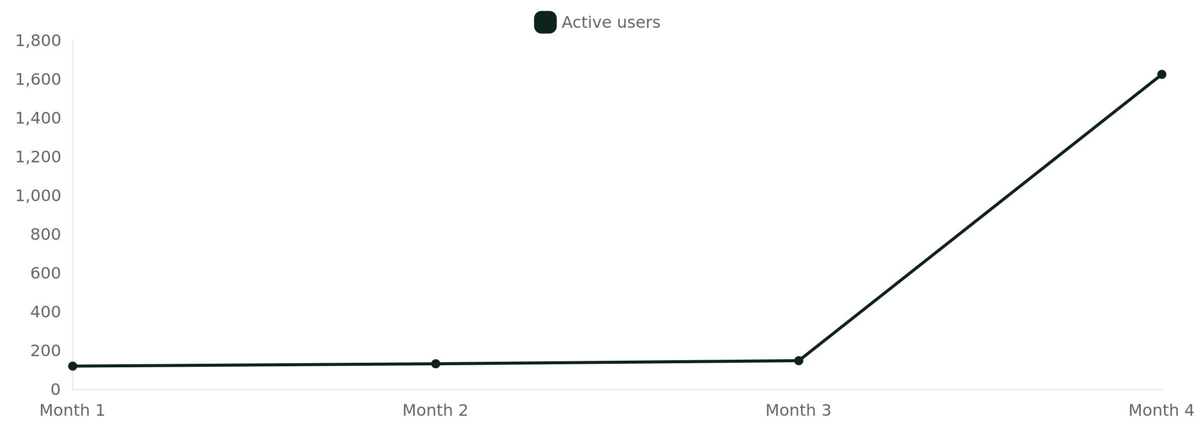
Quarterly Executive Business Review: Performance, Impact, and Strategic Partnership
5
Usage Metrics & Adoption Trends

Slide 6
Quarterly Executive Business Review: Performance, Impact, and Strategic Partnership
6
Business Impact & ROI Delivered
Cost saved
Revenue generated
Hours saved
Operational impact
Summarize quantified savings tied to automation, reduced rework, or vendor consolidation
Quantify attributable uplift such as conversion lift or pipeline acceleration
Estimate productivity gains from streamlined workflows and fewer manual steps
Reliability and SLA outcomes that reduce downtime and escalation load

Slide 7
Quarterly Executive Business Review: Performance, Impact, and Strategic Partnership
7
Challenges & Risk Mitigation
Blockers encountered
Resolution status
list the top issues impacting goals, adoption, or operational stability
current state, root-cause summary, and what is fully resolved versus in progress
Ongoing support plan
Risk outlook
escalation path, success checks, and monitoring cadence through next quarter
what could prevent success and the mitigation actions already underway

Slide 8
Quarterly Executive Business Review: Performance, Impact, and Strategic Partnership
8
Next Quarter Strategic Goals & OKRs
North Star Outcome
the measurable business result we will drive together
OKR Layer
3–5 objectives with key measurable outcomes and owners
Execution Layer
enablement, adoption motions, and operational improvements required to hit OKRs
Success Criteria
how we will validate progress before the next QBR

Slide 9
Quarterly Executive Business Review: Performance, Impact, and Strategic Partnership
9
Partnership Roadmap & Mutual Action Plan
Mutual Action Plan
Product Feature Preview
Renewal Timeline
Measurement Plan
Prioritized actions with owners, dependencies, and due dates
Planned capabilities that support the next quarter OKRs
Key milestones for renewal readiness and executive alignment checks
Reporting cadence, KPI tracking, and governance for ongoing risk control

