Slide 1

Exclusive Luxury Home Selling Strategy
A Comprehensive Approach to Premium Positioning, Marketing, and Successful Sales Execution

Slide 2
Exclusive Luxury Home Selling Strategy
2
Luxury Listing, Exclusive Outcome
Position Your Home as a Rare Opportunity
My Promise to You
Today’s Agenda
Crafted storytelling, premium presentation, and disciplined execution
Measurable demand creation, transparent guidance, and a listing experience built for confidence
Strategy, pricing logic, marketing plan, and a clear path to your next steps

Slide 3
Exclusive Luxury Home Selling Strategy
3
About My Agency
Boutique Luxury Focus
Proven Playbook
Service Standards
Boutique luxury focus with a concierge approach to every detail of your sale
A proven playbook: refined positioning, selective outreach, and high-intent buyer targeting
Service standards: communication cadence, marketing accountability, and data-backed recommendations

Slide 4
Exclusive Luxury Home Selling Strategy
4
Market Overview (What Buyers Are Responding To)
Key Drivers of Buyer Demand
Buyer demand is driven by condition, layout flow, natural light, and neighborhood desirability
Winning Competitive Listings
Competitive listings win when they combine strong pricing discipline with premium imagery and narrative
Your Market Advantage
Your advantage: differentiating features and positioning can create urgency even in balanced markets

Slide 5
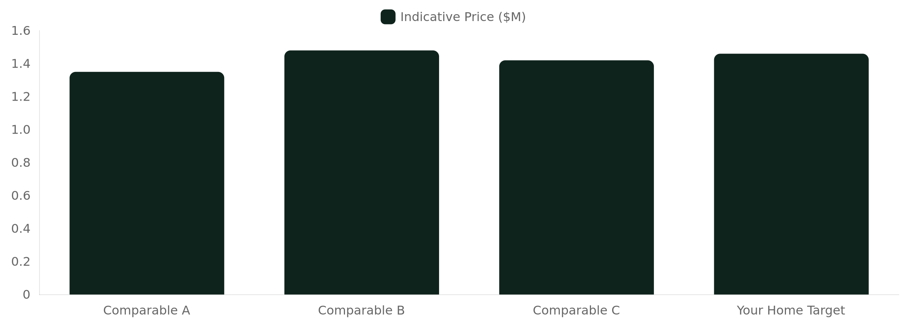
Exclusive Luxury Home Selling Strategy
5
Comparative Market Analysis (CMA) Snapshot

Slide 6
Exclusive Luxury Home Selling Strategy
6
Tailored Marketing Strategy (Digital & Physical)
Digital Marketing Tactics
Premium listing visuals
Targeted buyer audiences
High-signal lead tracking
Physical Marketing Approaches
Luxury print materials
Curated open-house presence
Neighborhood-level visibility
Selective Exposure Strategy
We prioritize quality of interest over volume to attract serious buyers

Slide 7
Exclusive Luxury Home Selling Strategy
7
Pricing Strategy (How We Create Buyer Urgency)
Initial Price for Early Activity
Pricing Range Framework
Aligning Price with Presentation
We set an initial price designed to generate strong early activity and protect your leverage
We use a pricing range framework with clear adjustment triggers tied to market response
We align price with presentation quality so the home is judged at its best, not its baseline

Slide 8

Exclusive Luxury Home Selling Strategy
8
Home Staging Tips (Luxury-Grade Presentation)
Declutter and elevate
Light and texture
Room-by-room focus
Finalize details
Remove distractions, refine surfaces, and create intentional visual flow
Enhance natural light, layer warm neutrals, and spotlight premium materials
Stage key spaces first (entry, living, primary suite) to shape first impressions
Artwork placement, hardware polish, scent strategy, and camera-ready angles

Slide 9
Exclusive Luxury Home Selling Strategy
9
Client Testimonials (Results-Driven Confidence)
Exceptional Marketing Impact
Clear and Strategic Pricing
Consistent and Purposeful Communication
“The marketing was exceptional—our home looked like a magazine and attracted the right buyers fast.”
“Pricing guidance was clear and strategic. We felt in control the entire time.”
“Communication was consistent and proactive. Every step had a purpose.”

Slide 10
Exclusive Luxury Home Selling Strategy
10
Timeline to Sale (A Calm, Controlled Process)
Launch
Close
digital rollout, physical presence, and buyer engagement monitoring
final inspections support, documentation, and seamless handoff
Preparation
Negotiation
staging, photography readiness, and final pricing alignment
offers review, strategy for counteroffers, and contract-to-close coordination

Slide 11
Exclusive Luxury Home Selling Strategy
11
What You Get With an Exclusive Listing
Top priority
dedicated strategy
premium marketing execution
Mid-level execution
curated staging guidance
high-end visuals
Foundation
data-driven CMA
pricing discipline

Slide 12
Exclusive Luxury Home Selling Strategy
12
Call to Action / Next Steps
Confirm exclusivity
Lock the plan
Start now
review the listing terms and schedule your launch preparation
staging checklist, photography timeline, and final pricing confirmation
sign the exclusive listing agreement and begin the luxury marketing rollout

