Slide 1
Comprehensive Financial Performance and Forecast Review
Analyzing Quarterly Results, Cash Flows, and Strategic Projections for Informed Decision-Making

Slide 2

Executive Summary (Board Snapshot)
Quarterly headline
Balance sheet and cash position
Board actions requested
Revenue and profitability direction versus prior quarter, with clear drivers
Liquidity status, working-capital movements, and risk flags
Approve budget adjustments and confirm forecast assumptions
2
/
Comprehensive Financial Performance and Forecast Review

Slide 3
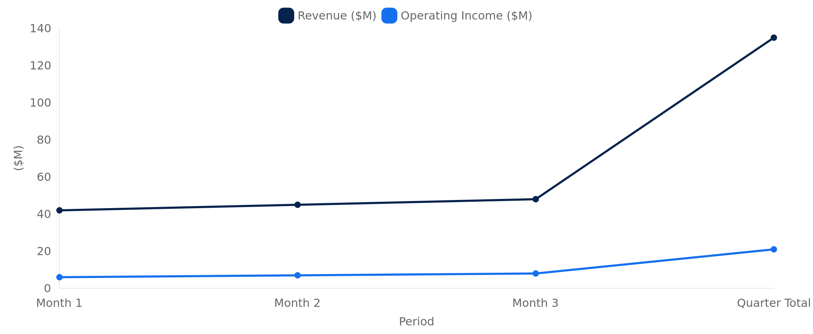
Quarterly Performance Overview (Top-Line to Bottom-Line)
3
/
Comprehensive Financial Performance and Forecast Review

Slide 4
Income Statement Highlights (What Drove Results)
Gross Margin Analysis
Operating Expenses Breakdown
Earnings Bridge Summary
Quantify price/mix versus input-cost effects and highlight key variances
Show controllable cost moves (labor, overhead, discretionary spend)
Summarize operating profit to net profit including taxes and other items
4
/
Comprehensive Financial Performance and Forecast Review

Slide 5
Balance Sheet Summary (Liquidity, Leverage, Working Capital)
Metric | Current Quarter | Prior Quarter
Cash & Equivalents | $62M | $55M
Working Capital | $18M | $12M
Total Debt | $140M | $142M
5
/
Comprehensive Financial Performance and Forecast Review

Slide 6

Cash Flow Analysis (Cash Conversion and Use of Funds)
Operating cash flow
Investing cash flow
Financing cash flow
explain drivers from earnings quality and working-capital timing
summarize capex and strategic investments, plus expected payback
dividends, debt service, and net change in cash reconciliation
6
/
Comprehensive Financial Performance and Forecast Review

Slide 7
Key Financial Metrics / KPIs (ROI, EBITDA, and Margin)
EBITDA and Margin
Return on Investment (ROI)
Cash Conversion
EBITDA & Margin
ROI
Cash Conversion
EBITDA: report value and margin with a short driver note (volume, pricing, cost)
ROI: show return versus capital deployed and explain whether gains are operational or one-off
Cash conversion: link EBITDA to operating cash flow to assess earnings quality
7
/
Comprehensive Financial Performance and Forecast Review

Slide 8
Departmental Budgets (Variance and Accountability)
Department | Budget ($M) | Actual ($M) | Variance ($M)
Sales & Marketing | 28.0 | 30.2 | -2.2
Operations | 34.5 | 33.6 | 0.9
G&A | 16.0 | 15.4 | 0.6
8
/
Comprehensive Financial Performance and Forecast Review

Slide 9
Future Forecasts / Projections (Next Quarter Outlook and Assumptions)
Base Case Forecast
Sensitivity View
Decision Path
Revenue and margin outlook with key operational assumptions stated upfront
Highlight how changes in volume, pricing, and input costs impact net income and cash
Approve forecast ranges, capex timing, and budget reallocations for execution
9
/
Comprehensive Financial Performance and Forecast Review

