Slide 1


Strategic Business Initiative Proposal
Comprehensive Plan to Drive Growth, Efficiency, and Risk Mitigation Through Targeted Solutions

Slide 2
Table of Contents
The Opportunity: Why This Matters Now
The Problem Statement: The Cost of Inaction
Proposed Solution: What We Will Deliver
Strategic Alignment: How This Advances Leadership P…
Required Resources & Budget: Investment Plan
Risk Assessment & Mitigation: Protect Value and Del…
Estimated ROI: Business Impact and Payback
Implementation Timeline (Gantt Placeholder): From A…
03
04
05
06
07
08
09
10

Slide 3
The Opportunity: Why This Matters Now
Define the growth or efficiency opportunity in executive terms
Quantify the upside with directional metrics
State the urgency
revenue, cost, risk, customer impact
market demand, pipeline, churn, cycle time, compliance exposure
what changes if we act now versus later
Strategic Business Initiative Proposal
3

Slide 4
The Problem Statement: The Cost of Inaction
Describe the current state gap: where performance is falling short and why
Highlight root causes: process, technology, data, capacity, or governance constraints
Make the business impact explicit: customer friction, operational drag, revenue leakage, and brand risk
Describe the current state gap: where performance is falling short and why
Highlight root causes: process, technology, data, capacity, or governance constraints
Make the business impact explicit: customer friction, operational drag, revenue leakage, and brand risk
Strategic Business Initiative Proposal
4

Slide 5
Proposed Solution: What We Will Deliver
Present the solution in one sentence
Outline the key deliverables and scope boundaries
Specify success criteria
the new capability and measurable outcomes
in-scope / out-of-scope
KPIs, service levels, and acceptance thresholds
Strategic Business Initiative Proposal
5

Slide 6
Strategic Alignment: How This Advances Leadership Priorities
Map to Top Strategic Themes
Growth
Customer Experience
Operational Excellence
Risk Reduction
Linkage to Existing Initiatives
Explain the linkage to existing initiatives and how this accelerates or de-risks them
Clarify Decision Dependencies
What leadership must approve to unlock execution
Strategic Business Initiative Proposal
6

Slide 7
Required Resources & Budget: Investment Plan
Required Roles and Effort
Product, Engineering, Data, Operations, Legal/Compliance, Change Management
Budget Envelope by Cost Category
People, tools, vendors, training, contingency
Funding Ask and Timing
Amount, funding source, and approval milestones
Strategic Business Initiative Proposal
7

Slide 8
Risk Assessment & Mitigation: Protect Value and Delivery
Identify Top Risks
Propose Mitigation Actions
Define Risk Controls and Escalation
Identify top risks across scope, timeline, cost, adoption, security, and compliance
Propose mitigation actions with owners (pre-mortems, vendor SLAs, security reviews, change plan)
Define risk controls and escalation triggers (what happens if KPIs or milestones slip)
Strategic Business Initiative Proposal
8

Slide 9
Estimated ROI: Business Impact and Payback
Estimated Financial Impact and Payback Period
Primary ROI Drivers
Conservative vs. Target Assumptions
Estimated financial impact (benefits minus costs) with payback period
Primary ROI drivers (cost savings, revenue uplift, productivity gains, reduced incident exposure)
Conservative vs. target assumptions to ensure credibility and governance readiness
Strategic Business Initiative Proposal
9

Slide 10
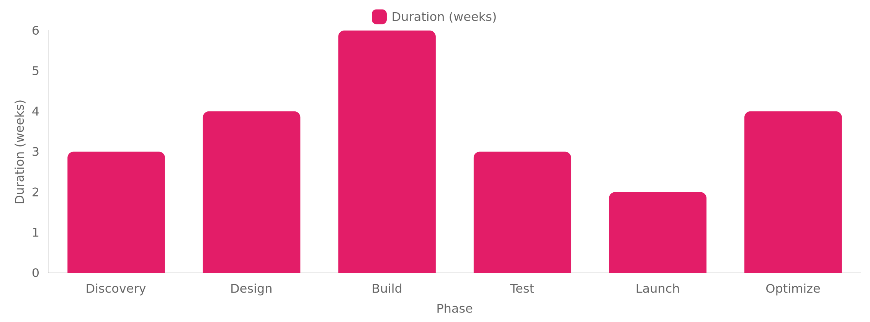
Implementation Timeline (Gantt Placeholder): From Approval to Outcomes
Strategic Business Initiative Proposal
10

