Slide 1
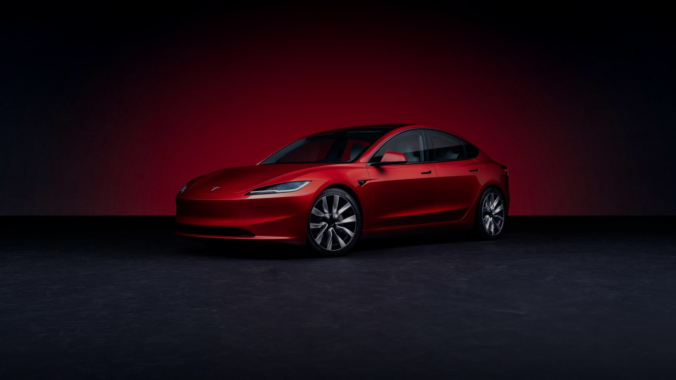





INVESTOR PRESENTATION
©2025 Tesla, Inc

Slide 2
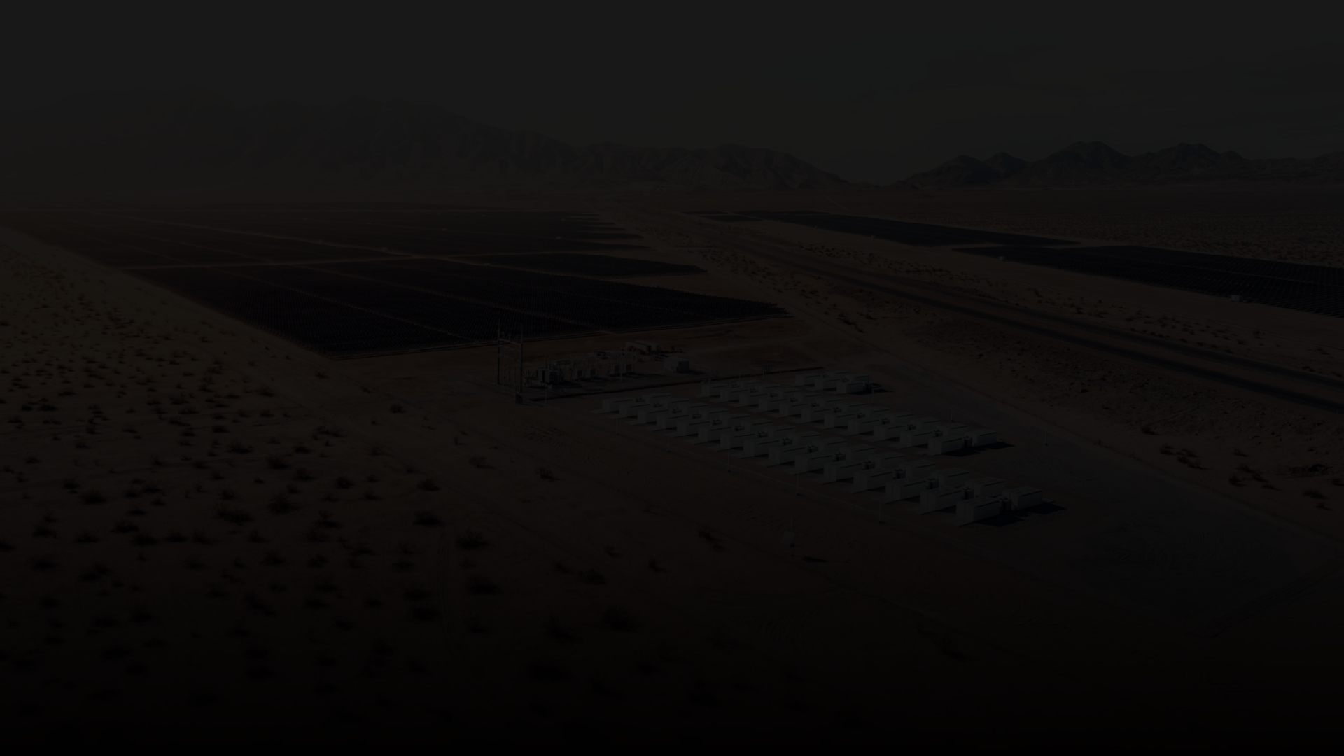

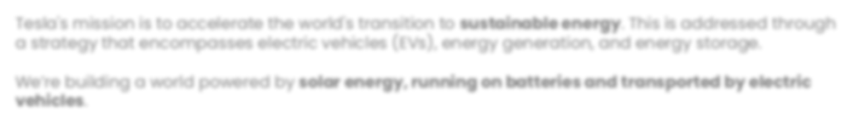

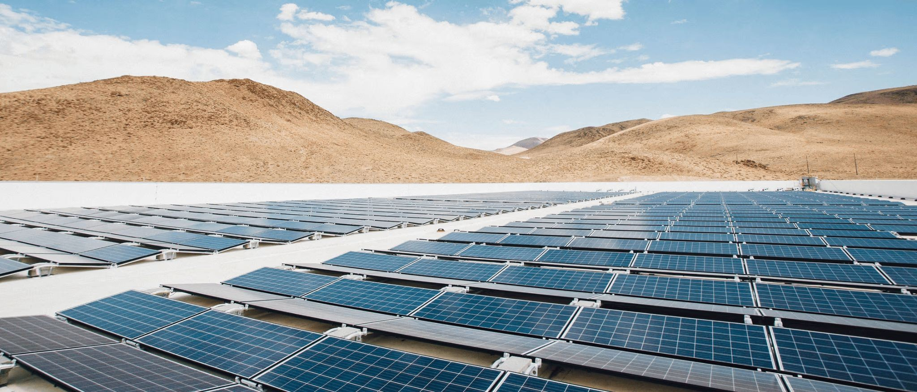

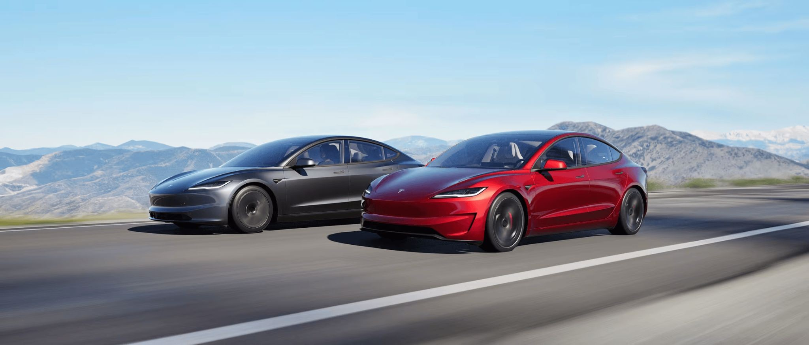
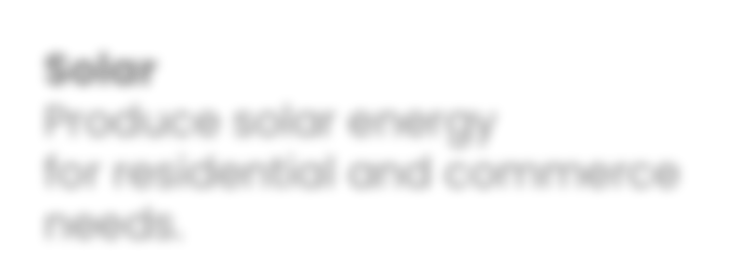
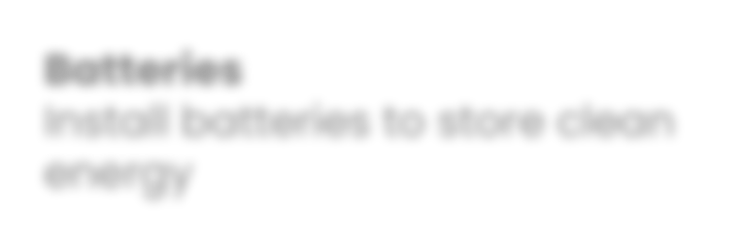
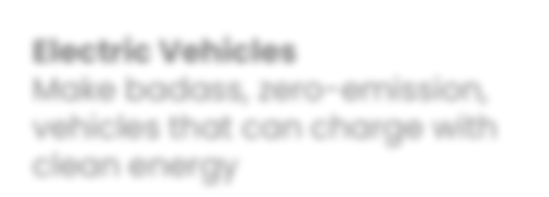


COMPANY MISSION
Tesla's mission is to accelerate the world's transition to sustainable energy. This is addressed through a strategy that encompasses electric vehicles (EVs), energy generation, and energy storage.
We’re building a world powered by solar energy, running on batteries and transported by electric vehicles.
Solar
Produce solar energy
for residential and commerce needs.
Batteries
Install batteries to store clean energy
Electric Vehicles
Make badass, zero-emission, vehicles that can charge with clean energy
©2025 Tesla, Inc
2

Slide 3
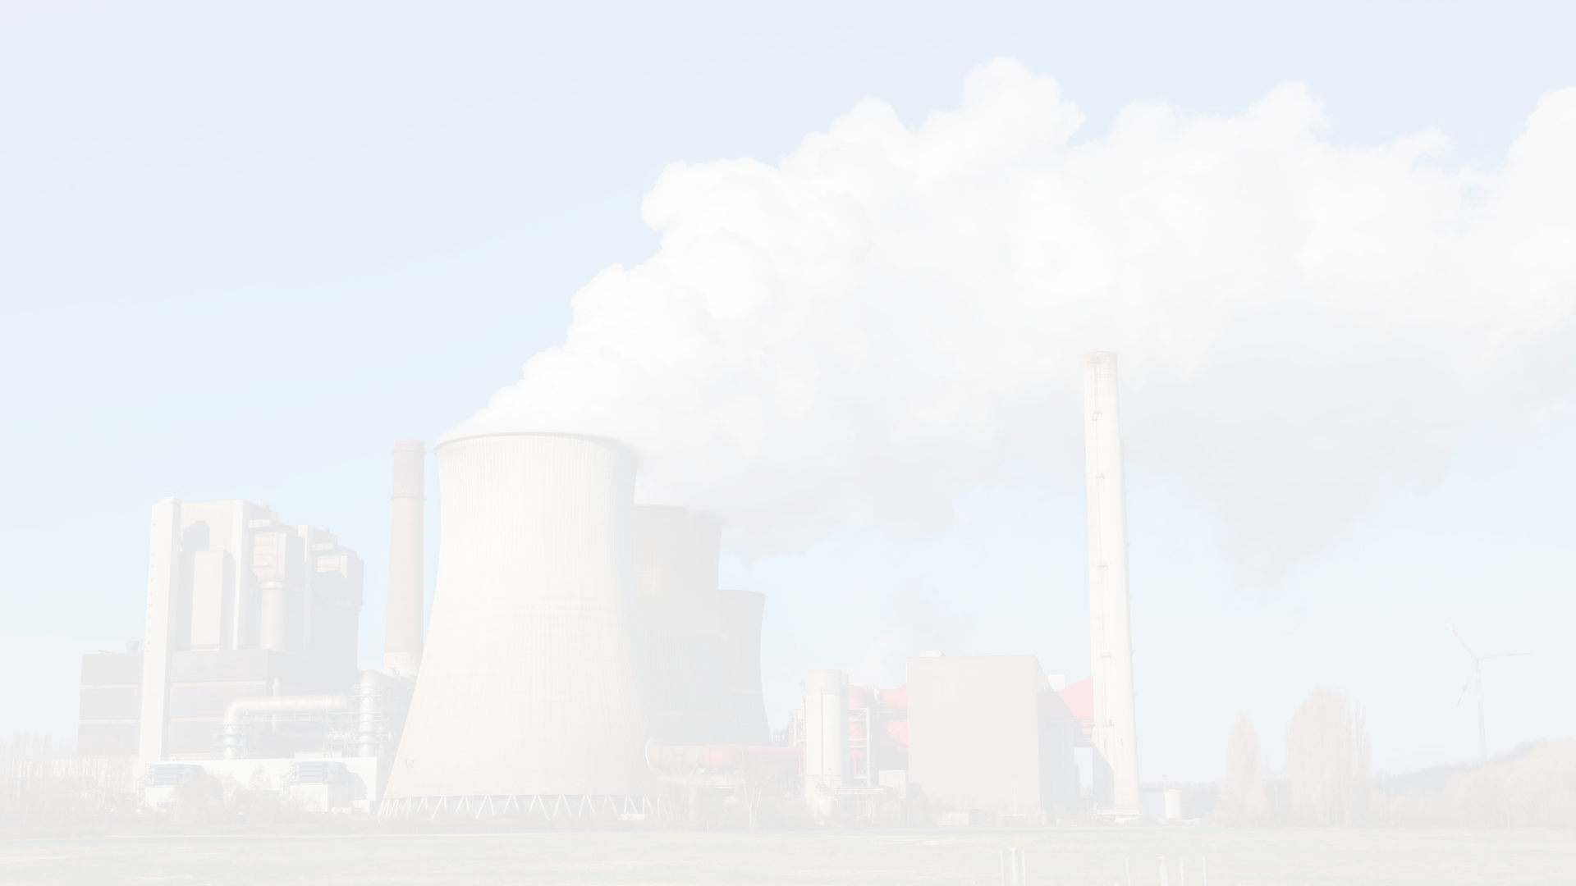
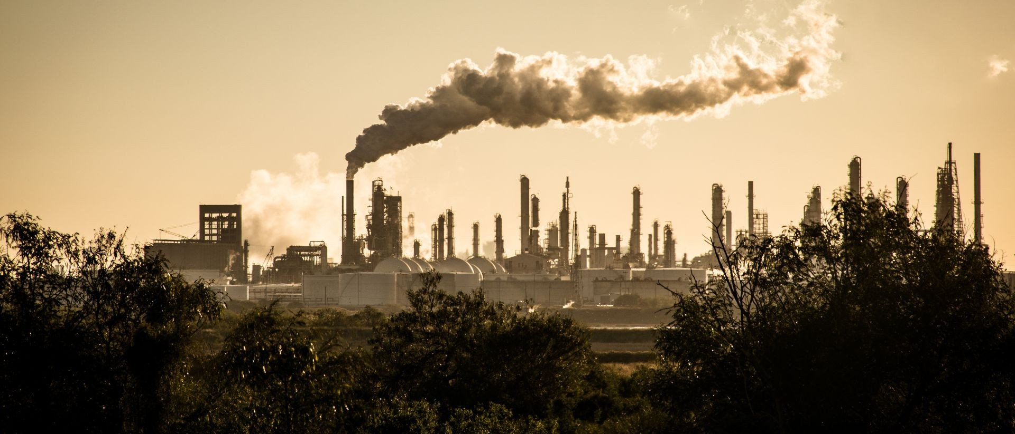
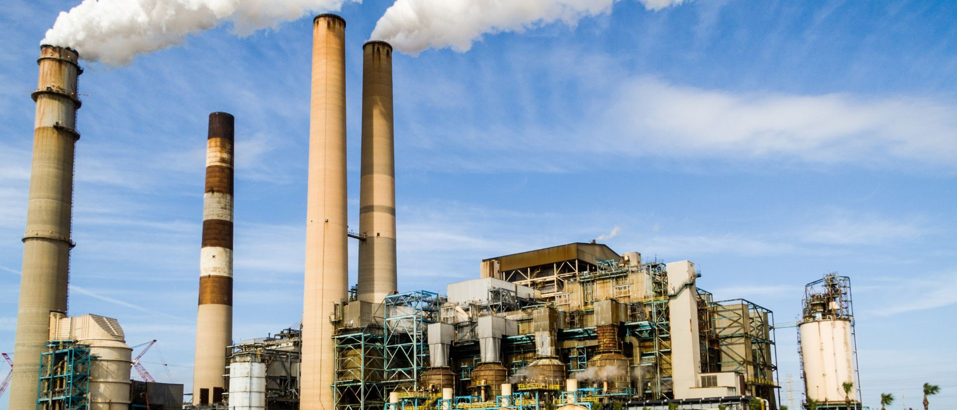
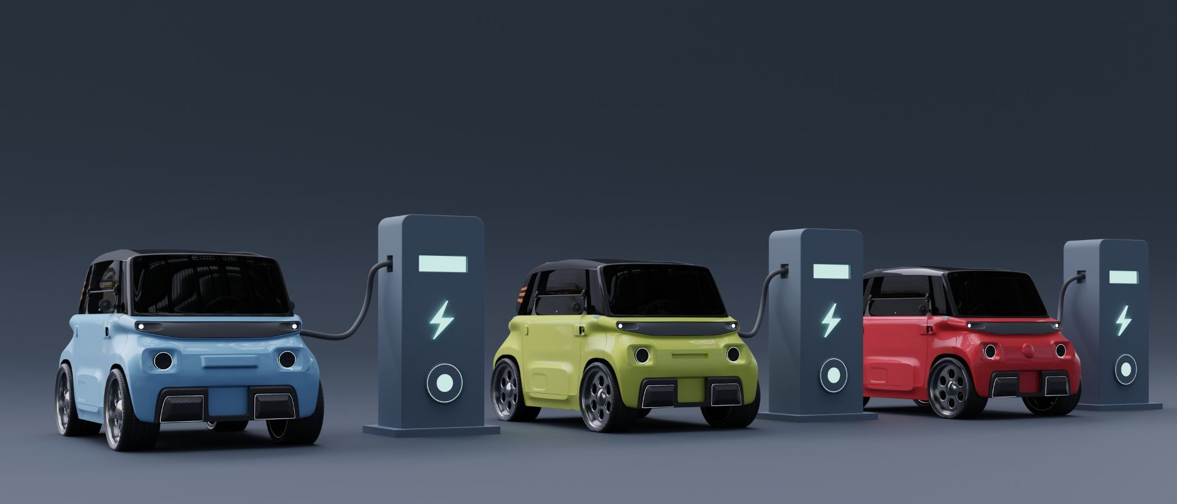
PROBLEM
Tesla's founding premise is that the global reliance on fossil fuels for transportation and power generation is environmentally and economically unsustainable.
Greenhouse gas emissions
The burning of fossil fuels releases greenhouse gases, accelerating climate change.
Infrastructure inefficiency The existing energy infrastructure is inefficient and aging, leading to a reliance on non-renewable energy sources and high costs.
Lack of sustainable options Before Tesla, the market for electric and renewable energy products was limited and often failed to meet mainstream consumer needs for performance and cost.
©2025 Tesla, Inc
3

Slide 4

SOLUTION
A sustainable energy ecosystem
Tesla's solution is a vertically integrated ecosystem of products and technologies designed to create a sustainable future.
Electric Vehicles
Tesla's EVs were initially designed to prove that electric cars could be faster, safer, and more fun to drive than gasoline-powered cars.
High-performance vehicles
Mass-market adoption Charging network
Energy generation & storage
Tesla's energy products address of renewable power sources creating a more resilient grid.
the intermittent like solar and
nature wind,
High-performance vehicles
Mass-market adoption Charging network
AI and autonomy
Tesla develops advanced AI and robotics to create safer and more efficient transportation.
High-performance vehicles
Mass-market adoption Charging network
©2025 Tesla, Inc
4

Slide 5















































BUSINESS MODEL
Production
Website & Retail
INDIVIDUAL
CAR PRODUCTION
Usage/Customer Insights
Data Usage
COMMERCIAL FLEETS
CAR BATTERY
Tesla EV
CHARGE POINTS
Commercial
Home
SOLAR ENERGY
CHARGE POINTS
SOLAR ENERGY
Tesla Energy
Tesla Charge Point
©2025 Tesla, Inc
5

Slide 6









MARKET
Earning each tranche generally requires Elon to reach both a market capitalization milestone and operational milestone¹
Market Capitalization Milestones
+ =
Operational Milestones (Strategic & Financial)
Earned Shares per Tranche (Total = 12% of Company)²
$2,000,000,000,000
$2,500,000,000,000
$3,000,000,000,000
$3,500,000,000,000
$4,000,000,000,000
$4,500,000,000,000
$5,000,000,000,000
$5,500,000,000,000
$6,000,000,000,000
$6,500,000,000,000
$7,500,000,000,000
$8,500,000,000,000
20M Tesla Vehicles Delivered 10M Active FSD Subscriptions 1M Bots Delivered
1M Robotaxis in Commercial Operation
$50B Adj. EBITDA
$80B Adj. EBITDA
$130B Adj. EBITDA
$210B Adj. EBITDA
$300B Adj. EBITDA
$400B Adj. EBITDA
$400B Adj. EBITDA (over 4 separate consecutive quarters)
$400B Adj. EBITDA (over 4 separate consecutive quarters)
1. 1.0%
2. 1.0%
3. 1.0%
4. 1.0%
5. 1.0%
6. 1.0%
7. 1.0%
8. 1.0%
9. 1.0%
10. 1.0%
11. 1.0%³
12. 1.0%³
©2025 Tesla, Inc
Subject to additional provisions contained in the Company’s 2025 Proxy materials. “Earning each tranche” refers to the ability to vote the shares under each tranche.
Based on the total shares outstanding as of August 29, 2025 plus the 2018 CEO Performance Award minus the 2025 CEO Interim Award.
Earning the ability to vote the shares in the 11th and 12th tranches requires Elon to develop a framework for CEO succession
6

Slide 7








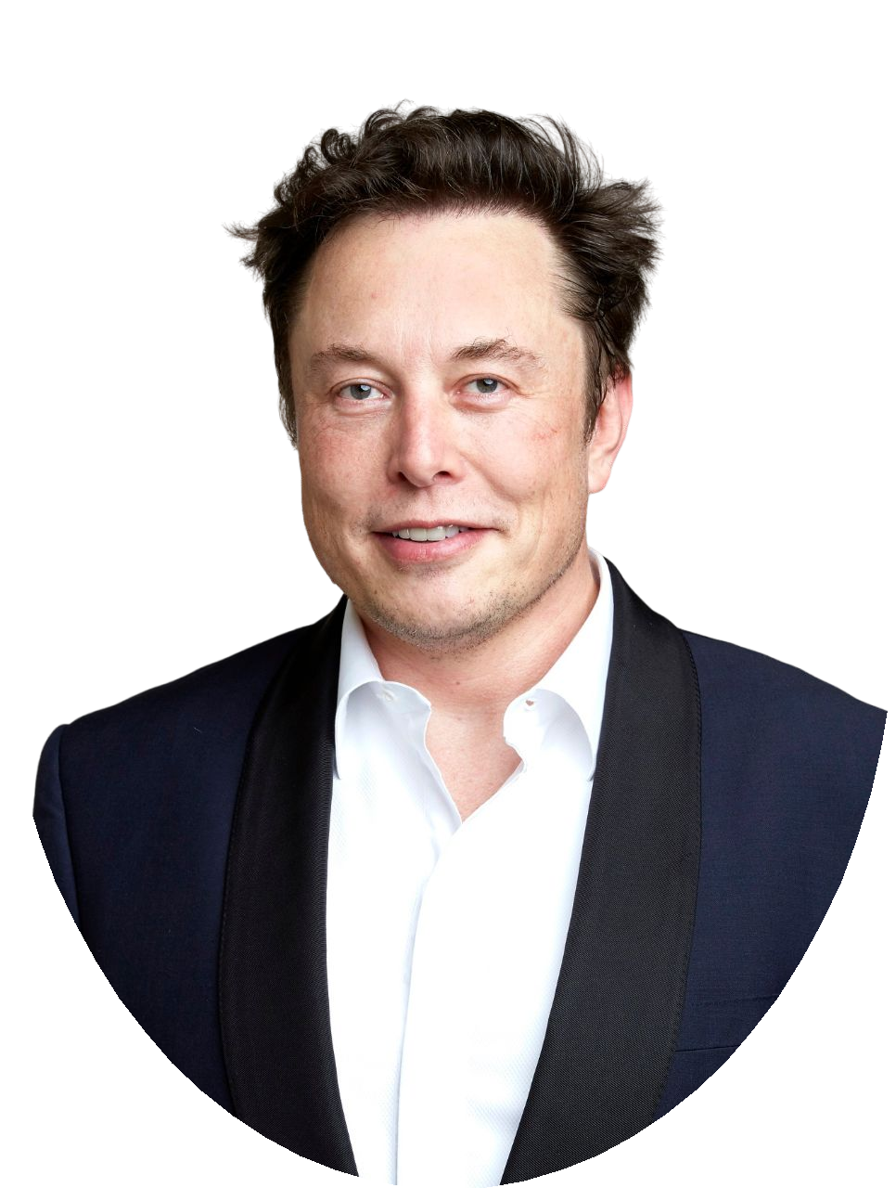
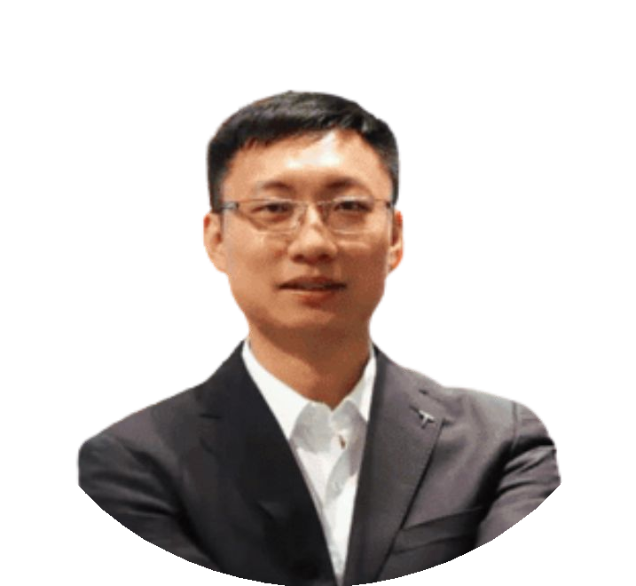

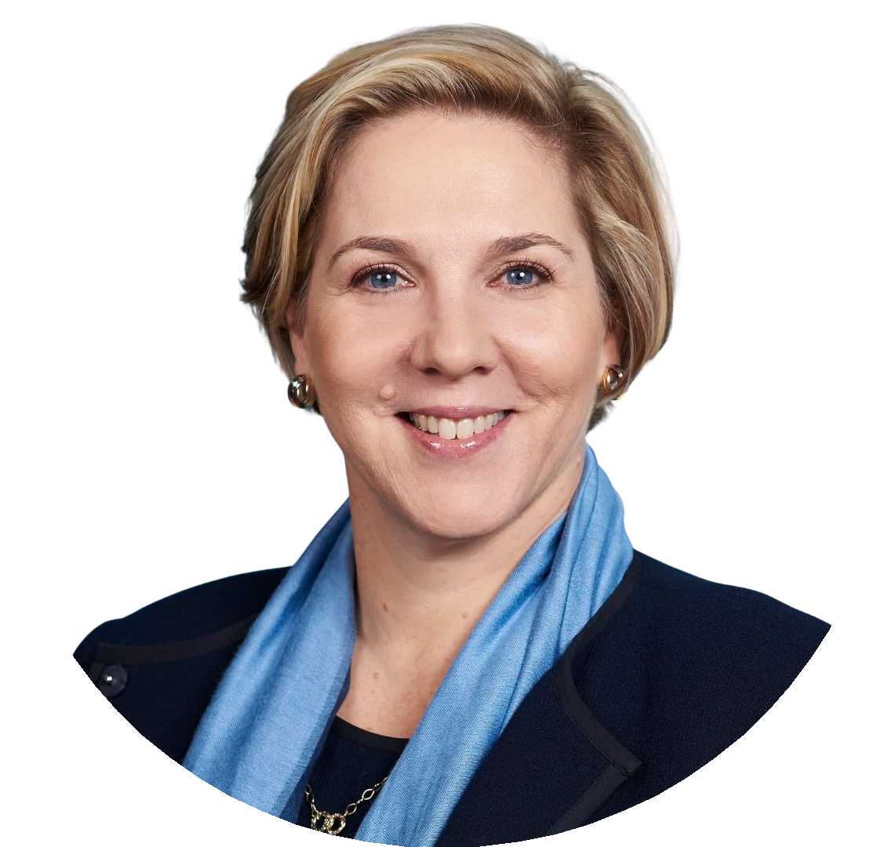
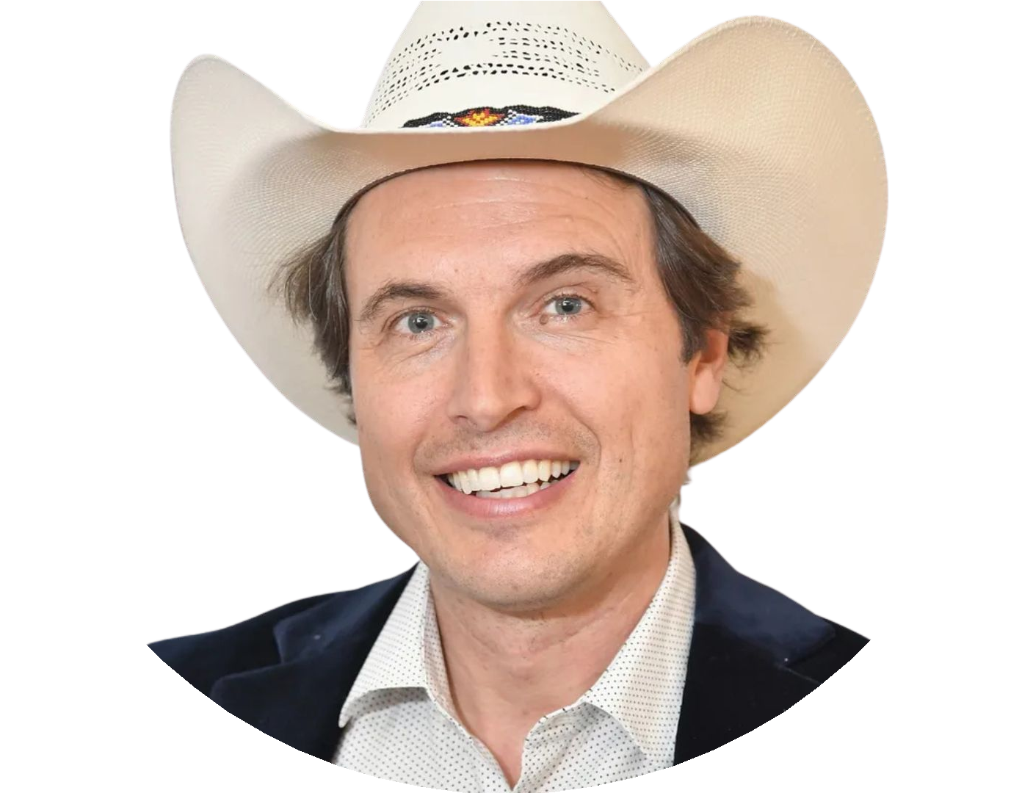


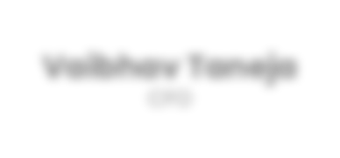

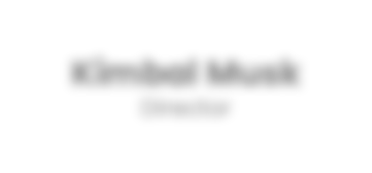





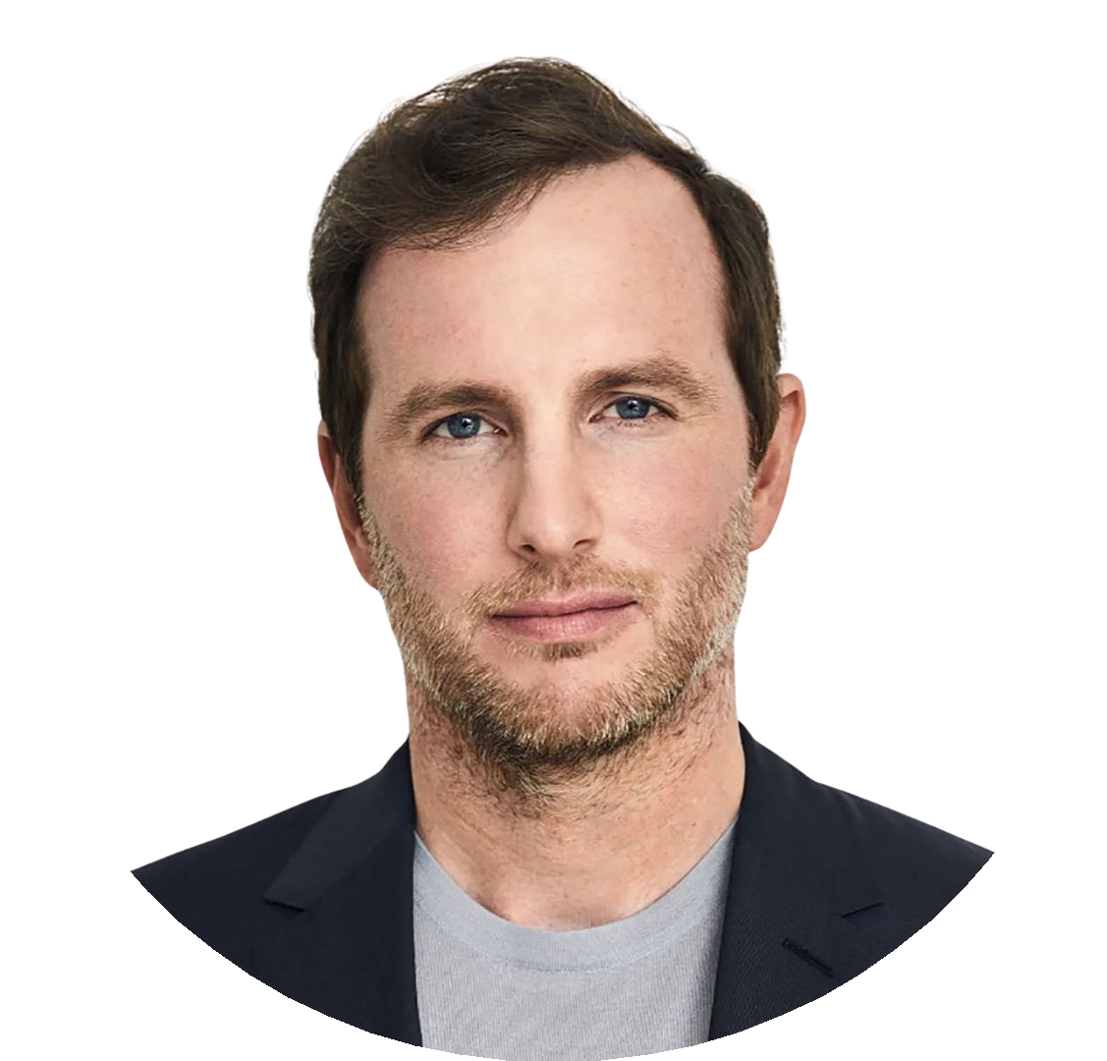



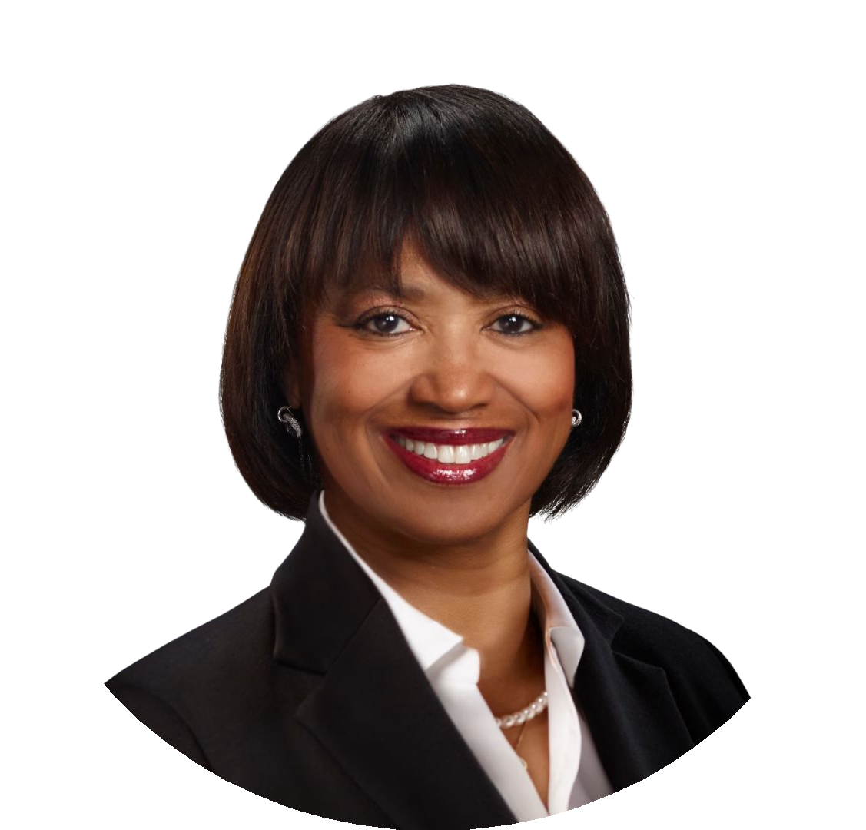

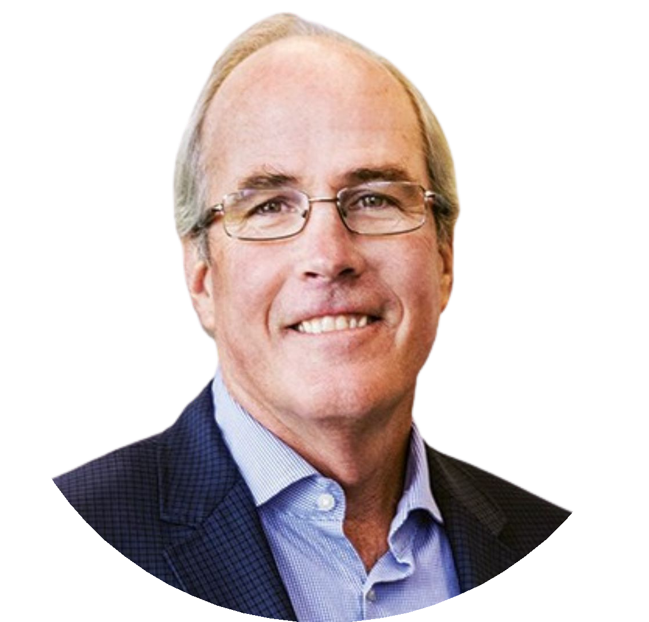







TEAM
Elon Musk
CEO - Product Architect
Tom Zhu
Senior VP
Vaibhav Taneja
CFO
Robyn M. Denholm
Independent Director
Kimbal Musk
Director
Joe Gebbia
Independent Director
James Murdoch
Independent Director
Ira Ehrenpreis
Independent Director
JB Straubel
Independent Director
Kathleen W-Thompson
Independent Director
Jack Hartung
Independent Director
©2025 Tesla, Inc
7

Slide 8


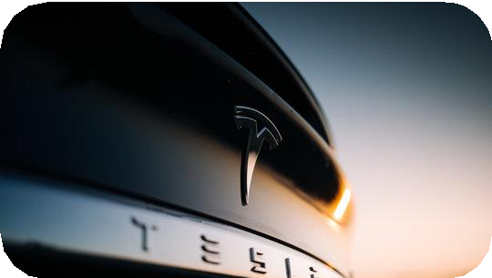
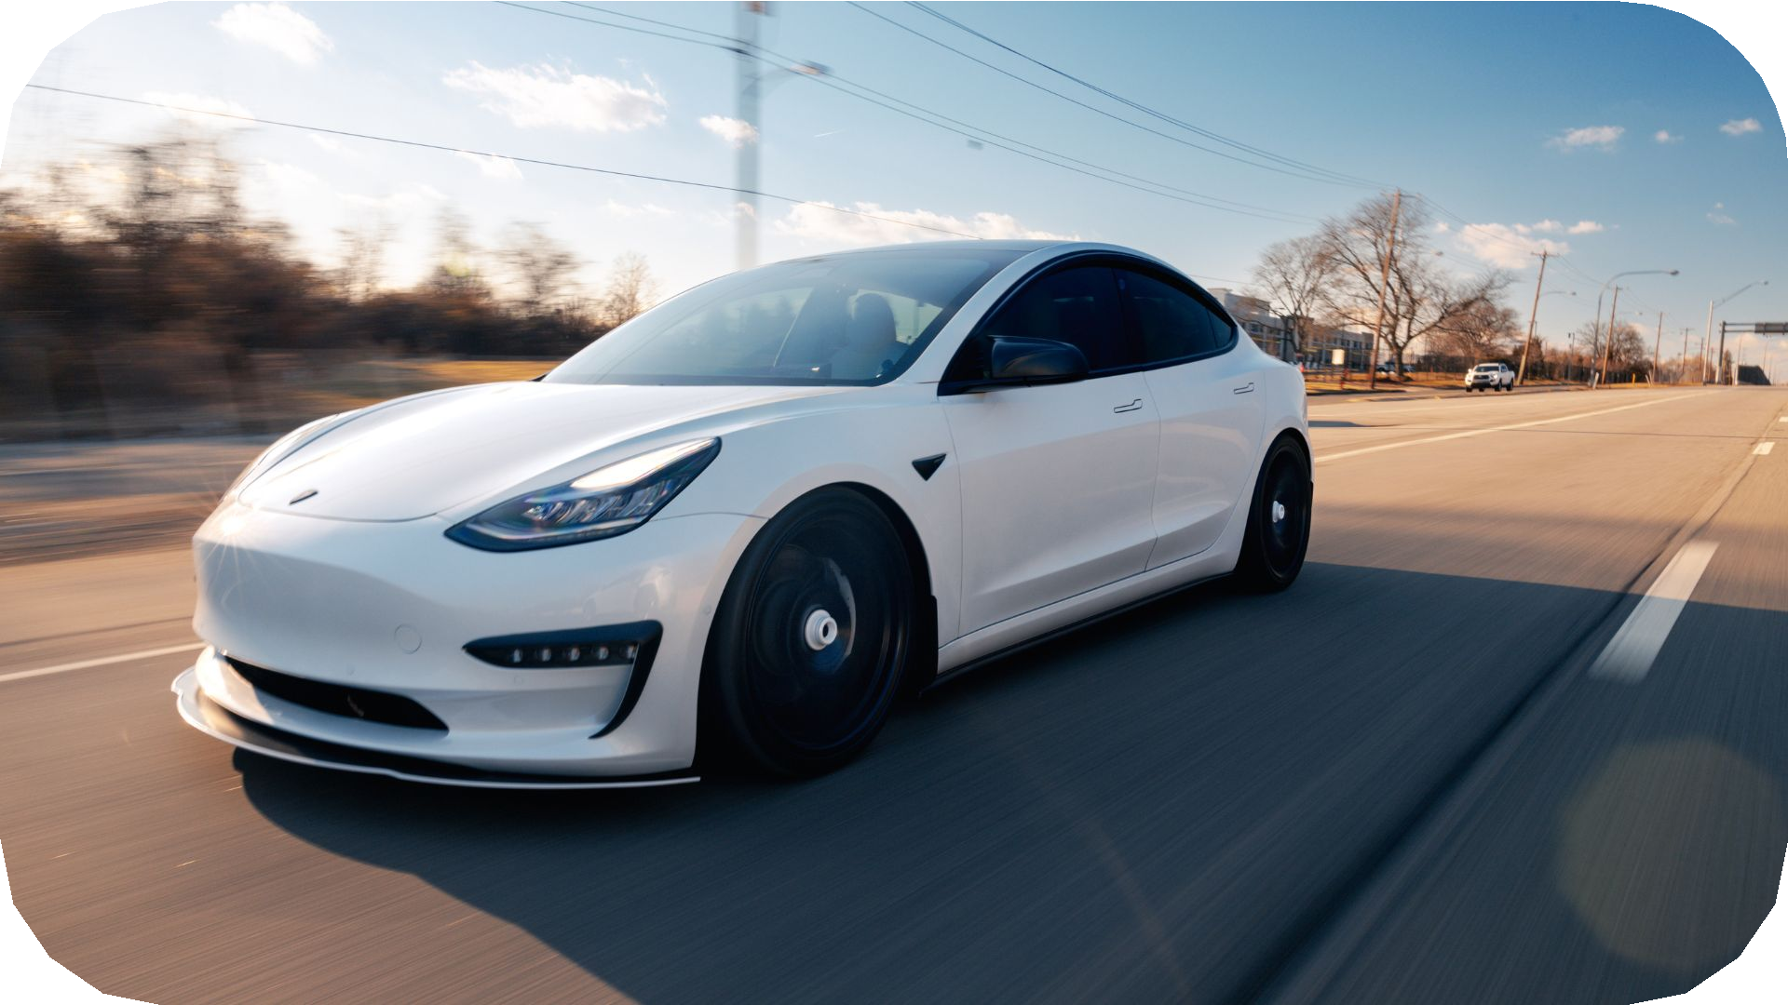
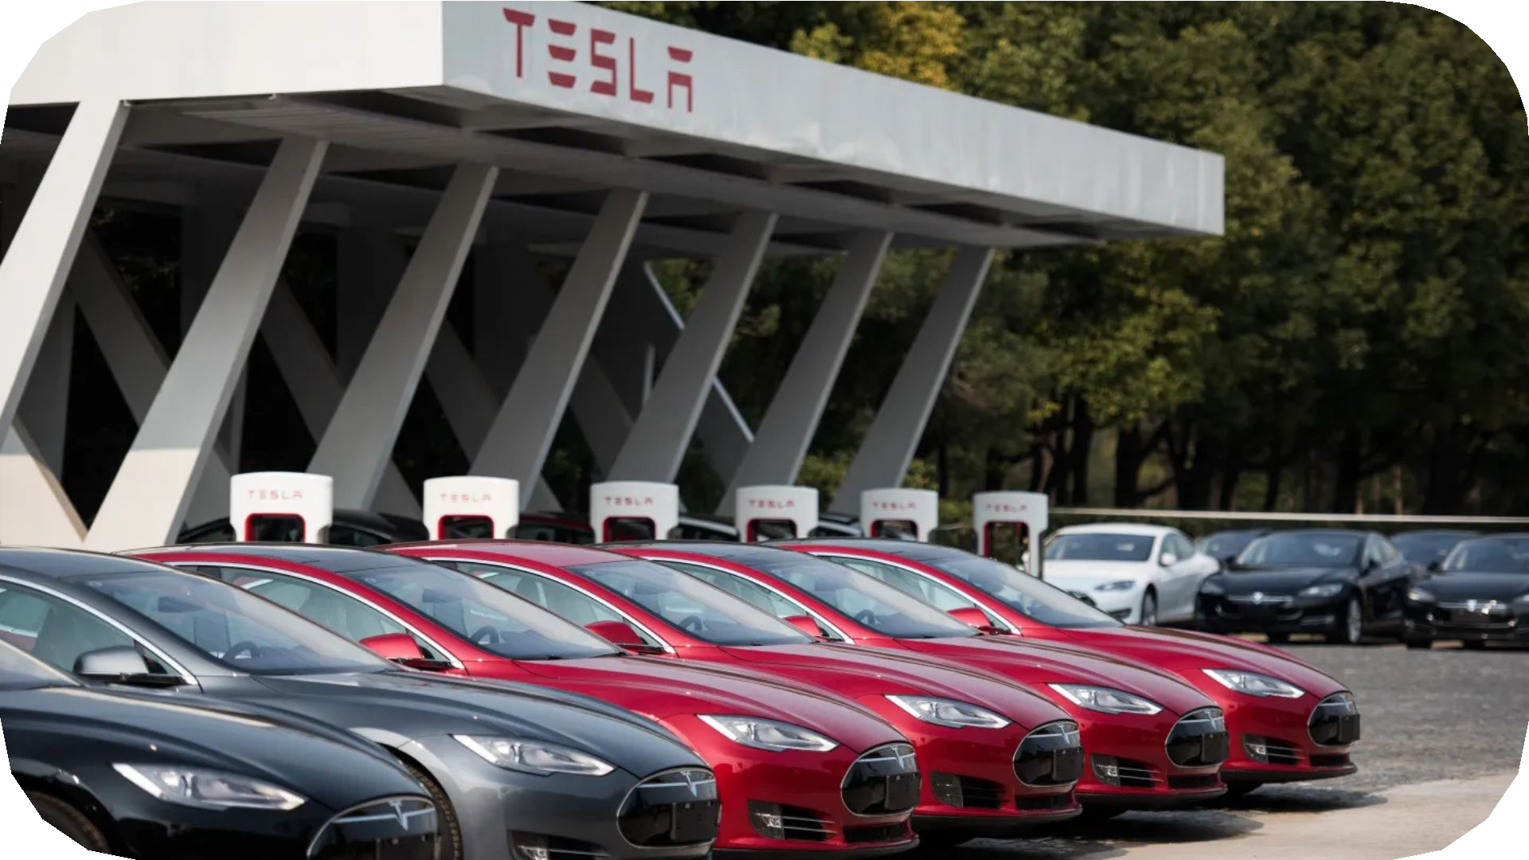
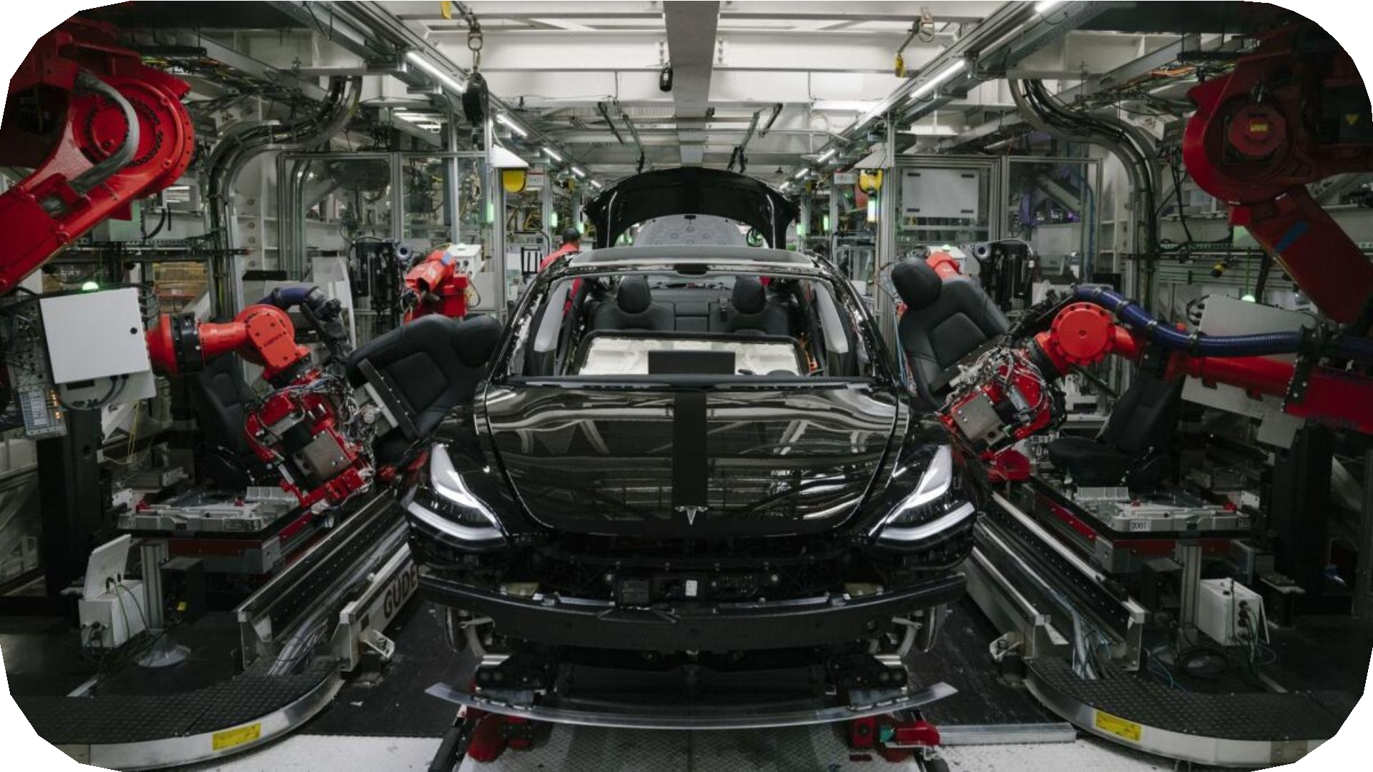
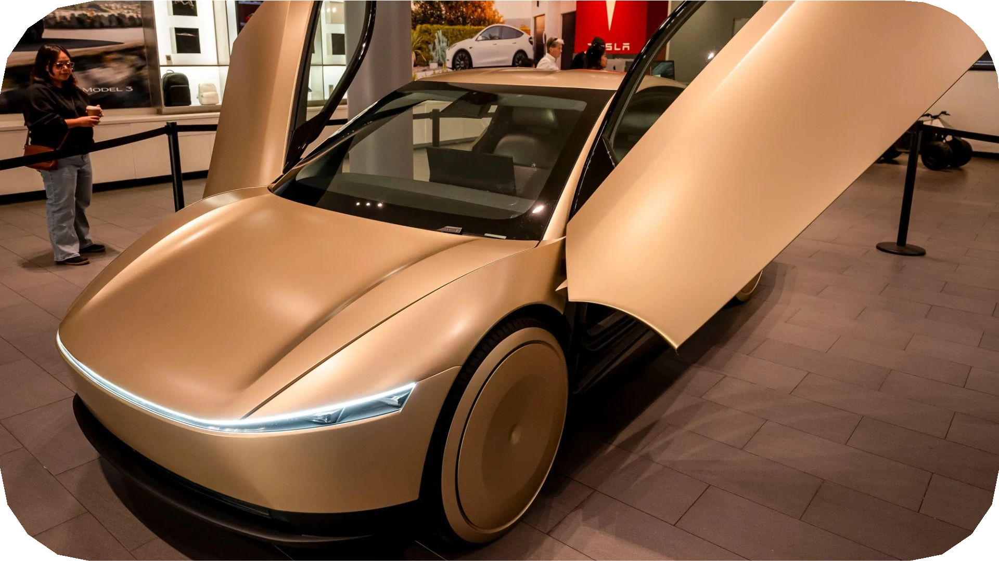
TRACTION
Pre-2018 Award
Loss-making, ambitious company with significant hurdles and challenges to overcome
Today
Industry-leading developer of autonomous driving and first vertically integrated sustainable energy company
$11.8 billion
In revenues¹
$92.7 billion
In revenues, an increase of ~8x⁵
$2.0 billion
Net loss²
$5.9 billion
Net income⁶
103,184
Vehicles delivered in 2017³
1,789,226
Vehicles delivered in 2024⁷
EVs not mainstream or popular
Only 1.2 million sold by all automakers in 2017⁴
Popularized EVs
8 millionth Tesla vehicles produced in June 2025⁸
0
Autonomous vehicles
Robotaxi
Launched in June in Austin
©2025 Tesla, Inc
1. Refers to 2017 full-year revenue, as set forth in Tesla’s Annual Report on Form 10-K for the year ended December 31, 2017, ﬁled with the U.S. Securities and Exchange Commission (the “SEC”) on February 23, 2018. 2. Refers to 2017 full-year net loss attributable to common stockholders (GAAP), as set forth in Tesla’s Annual Report on Form 10-K for the year ended December 31, 2017, ﬁled with the SEC on February 23, 2018. 3. Source: Tesla, Inc. May 2024 Investor Presentation, provided as Additional Deﬁnitive Proxy Soliciting Materials on Schedule DEFA14A, ﬁled with the SEC on May 23, 2024. 4. Source: Road Genius, “Global EV Sales (Cars) by Country” (https://roadgenius.com/cars/ev/statistics/sales-by-country/). 5. Refers to LTM revenue as of June 30, 2025, as set forth in the Tesla, Inc. Second Quarter Update, dated July 23, 2025, furnished as an exhibit to Tesla’s Current Report on Form 8-K ﬁled with the SEC on July 23, 2025. 6. Refers to LTM net income attributable to common stockholders (GAAP) as of June 30, 2025, as set forth in Tesla’s Quarterly Report on Form 10-Q for the three months ended June 30, 2025, ﬁled with the SEC on July 24, 2025, Tesla’s Quarterly Report on Form 10-Q for the three months ended March 31, 2025, ﬁled with the SEC on April 23, 2025, and Tesla’s Annual Report on Form 10-K for the year ended December 31, 2024, ﬁled with the SEC on January 30, 2025. 7. Source: Press Release of Tesla, Inc., dated January 2, 2025, furnished as an exhibit to Tesla’s Current Report on Form 8-K ﬁled with the SEC on January 2, 2025. 8. Source: Tesla, Inc. Second Quarter 2025 Update, dated July 23, 2025, furnished as an exhibit to Tesla’s Current Report on Form 8-K ﬁled with the SEC on July 23, 2025.
8

Slide 9

FINANCIALS
The adjustment EBITDA targets are ambitious
Each milestone is highly demanding and attainable only through meaningful, sustained business growth and real operational progress.
Adjusted EBITDA Target | vs. Q2’25 LTM¹
1 $50 Billion | ~3x
2 $80 Billion | ~5x
3 $130 Billion | ~9x
4 $210 Billion | ~14x
5 $300 Billion | ~20x
6 $400 Billion² | ~26x
7 $400 Billion² | ~26x
8 $400 Billion² | ~26x
$400B
$400B
$400B
$300B
$210B
$130B
$80B
~$6B
~$15B
$50B
Q2’25 LTM Net
Income Attribute to Common Stakeholders (GAAP)¹
Q2’25 LTM Adj.
EBITDA¹
Adj. EBITDA
Milestone 1
Adj. EBITDA
Milestone 2
Adj. EBITDA
Milestone 3
Adj. EBITDA
Milestone 4
Adj. EBITDA
Milestone 5
Adj. EBITDA
Milestone 6
Adj. EBITDA
Milestone 7
Adj. EBITDA
Milestone 7
©2025 Tesla, Inc
Source: Tesla, Inc. Second Quarter Update, dated July 23, 2025, furnished as an exhibit to Tesla’s Current Report on Form 8-K ﬁled with the SEC on July 23, 2025.
Each $400 billion Adjusted EBITDA milestone must be achieved over non-overlapping periods, each made up of four consecutive quarters.
9

Slide 10
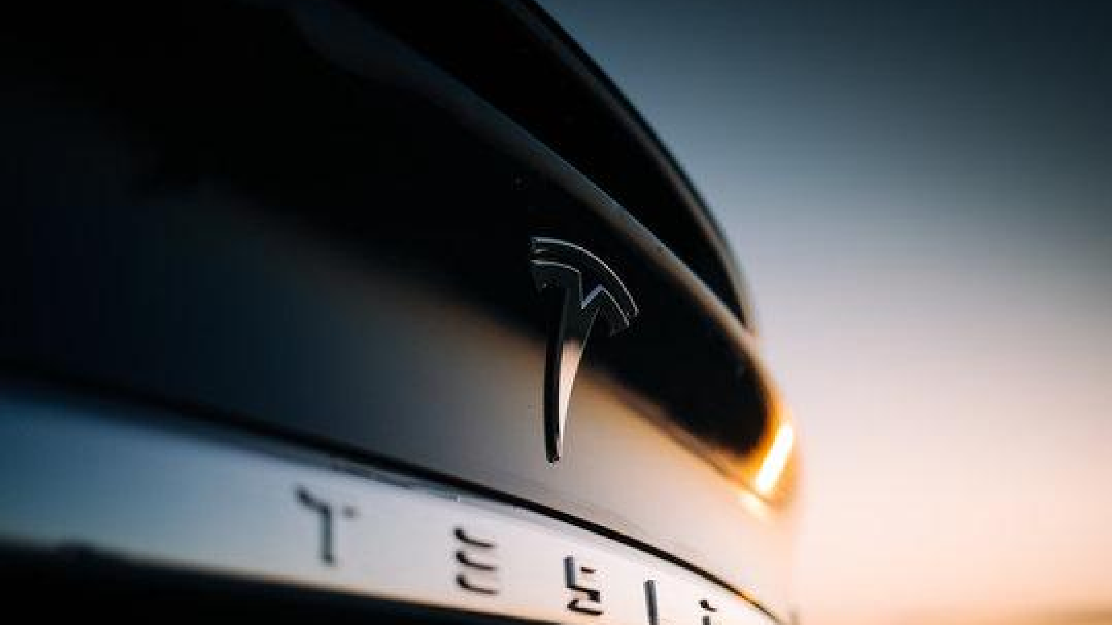
INVESTOR PRESENTATION

