Slide 1


McDonald’s Corporation
Investor Overview

Slide 2

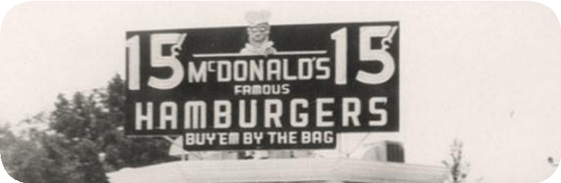
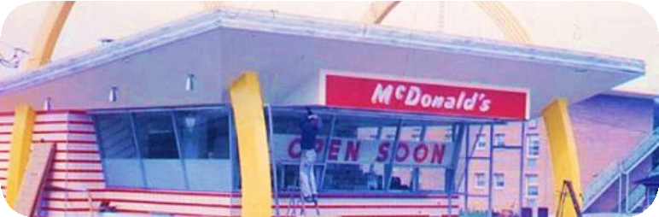
McDonald’s strategic evolution…
1950s
1960s, 1970s and 1980s
🡵 Kroc meets brothers Dick and Mac McDonald at their restaurant in San Bernardino.
🡵 Kroc becomes the national franchising agent for the McDonald brothers.
🡵 Kroc forms McDonald’s System, Inc. to issue McDonald’s
franchises under license from the McDonald brothers.
🡵 100 millionth hamburger sold by McDonald’s.
🡵 McDonald’s Corporation buys the exclusive rights to the McDonald’s
name and operating system from the McDonald brothers.
🡵 First location outside the U.S. opens.
🡵 McDonald’s expands globally to Tokyo, Amsterdam, Munich, and
Sydney.
🡵 The Big Mac, Egg McMuffin, Happy Meal, and Chicken McNuggets are invented and launched The first drive thru opens.

Slide 3

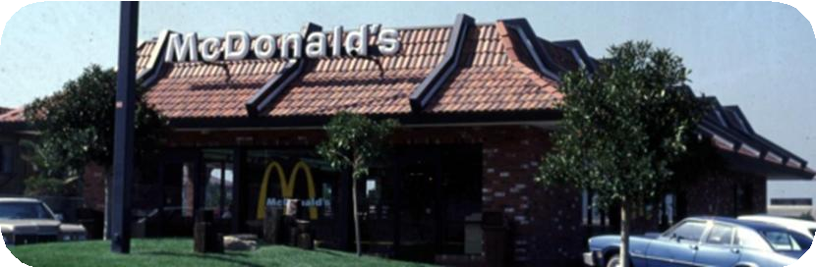
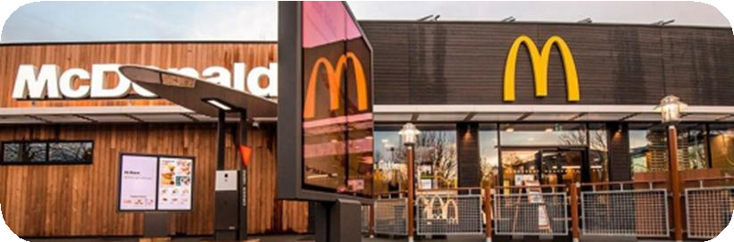
Continues To Meet Customer Needs Overtime
1990s & 2000s
2010s & 2020+
🡵 The McFlurry is invented and launched in Canada
🡵 Accelerated unit growth with continued international expansion
🡵 Plan to Win corporate strategy to focus on exceptional
customer experience
🡵 Dollar Menu value offerings i’m lovin’ it marketing
campaign launches
🡵 McCafé is invented and launched in Australia
🡵 Turnaround plan announcement (re-franchising, cost savings)
🡵 Velocity Growth Plan corporate strategy to focus on
🡵 Digital, Delivery, and U.S. Experience Of The Future
🡵 Accelerating the Arches corporate strategy to focus on Brand and M-C-D growth pillars: Marketing, Core, Digital, Delivery, Drive Thru and Development
🡵 Loyalty Program launches and rapidly expands to 60 markets around the globe

Slide 4
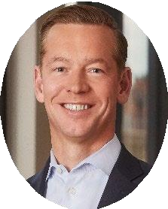
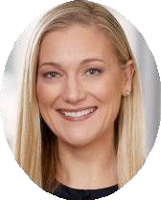
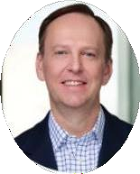
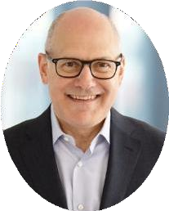
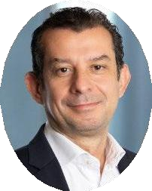
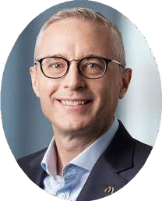
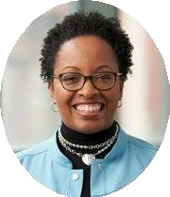
McDonald’s Senior Leadership Team
Chris Kempczinski
President and Chief Executive Officer 9 Years at McDonald’s
Skye Anderson
President, Global Business Services 25 Years at McDonald’s
Warren Anderson
Senior Vice President, Global Chief Supply Chain Officer 15 Years at McDonald’s
Jon Banner
Executive Vice President, Global Chief Impact Officer 3 Years at McDonald’s
Dario Baroni
President, IDL
9 Years at McDonald’s
Ian Borden
Executive Vice President, Global Chief
Financial Officer 30 Years at McDonald’s
Tiffanie Boyd
Executive Vice President, Global Chief
People Officer 4 Years at McDonald’s
For more information on McDonald’s leaders, see full biographies on the leadership page of the McDonald’s website

Slide 5
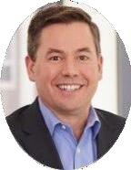
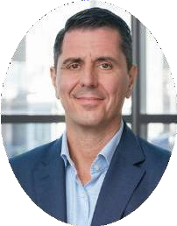
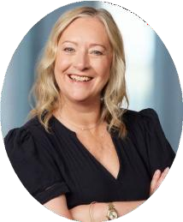
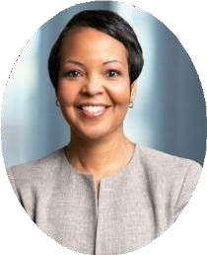
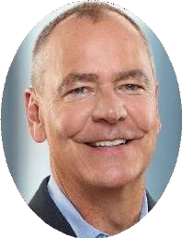
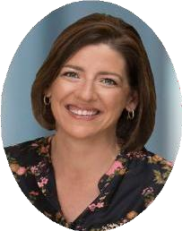
McDonald’s Senior Leadership Team
Joe Erlinger
President, McDonald's USA 22 Years at McDonald’s
ManuSteijaert
President, IOM
22 Years at McDonald’s
Jill McDonald
Executive Vice President, Global Chief Restaurant Experience Officer 11Years at McDonald’s
Desiree Ralls-Morrison
Executive Vice President, Global Chief Legal Officer 4 Years at McDonald’s
Brian Rice
Executive Vice President, Global Chief Information Officer 3 Years at McDonald’s
Morgan Flatley
Executive Vice President, Global Chief Marketing Officer and New Business Ventures
8 Years at McDonald’s
For more information on McDonald’s leaders, see full biographies on the leadership page of the McDonald’s website

Slide 6


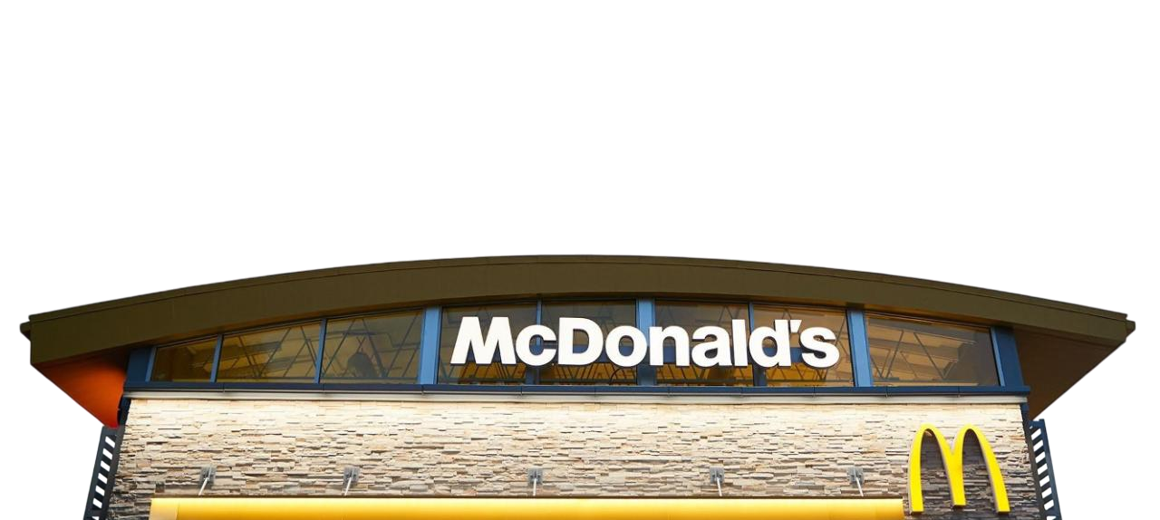
McDonald’s
43K+
Restaurants
2.2M
People
Workingfor McDonald’s or Franchisees
100+
Countries
~70Million
Customers
Servedeveryday

Slide 7

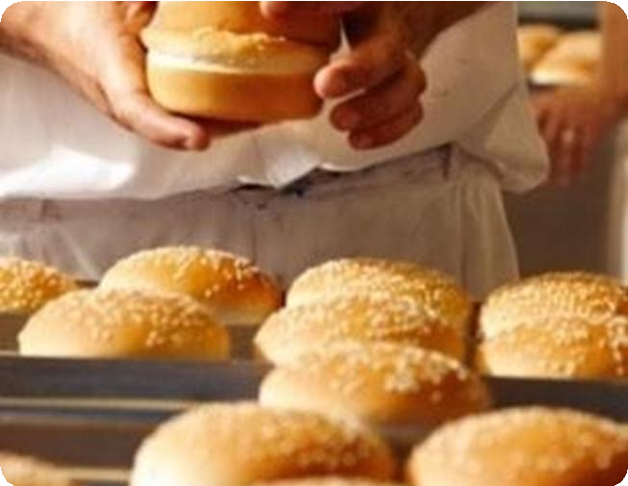
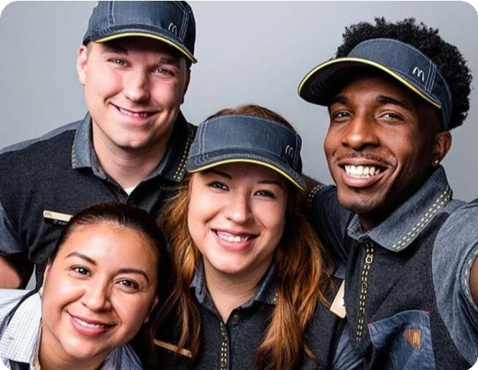
The McDonald’s System
The three-legged stool of McDonald’s franchisees, suppliers, and employees
Franchisees
95% of McDonald’s restaurants are locally owned and operated, providing the entrepreneurial spirit of local business owners
Suppliers
Employees
1in 8 Americans have worked at a McDonald's restaurant, learning skills that can go wherever they go
Many recognize McDonald’s as having the most integrated, efficient and innovative supply system in the food service industry
The balance of interests among the three groups is essential to McDonald’s success

Slide 8
McDonald’s Business Model
Revenues from rent, royalties and initial fees and profits from directly operating restaurants
Conventional License
~50% of Restaurants
Investment $ Profits
Developmental License
~20% of Restaurants
Investment $ Profits
Foreign-Affiliated
~25% of Restaurants
Investment $ Profits
McOpCo
~5% of Restaurants
Investment $ Profits
Operating profits (Cash flow)
Equipment
Equipment
+
Building
+
Real estate
Operating Profits
+
Rent
(Cash flow)
Equipment
+
Building
+
Real estate
Operating Profits
+
Rent
(Cash flow)
Equipment
+
Building
+
Real estate
All Operating profits
Building
+
Real estate
Rent
+
Royalties
Royalties
+
Equity in Earnings
Royalties
Rent and royalties
to the Company based upon a percent of sales with minimum rent payments
McDonald’s Franchisee
Royalties
to the Company based upon a percent of sales; licensees provide the capital to develop restaurants
Royalties
to the Company based upon a percent of sales and equity in earnings representing McDonald’s ownership stake
Profits
to the Company from directly operating restaurants

Slide 9









McDonald’s Global Business Operates Under 3 Segments
U.S., Intl Operated Markets, and Intl Developmental Licensed Markets & Corporate
U.S. Market
International
Operated Markets (IOM)
International Developmental Licensees & Corporate (IDL)
McDonald’slargest market
in terms of Systemwide sales
16+markets
or countries including Australia, Canada, France, Germanyand the U.K.
75+markets
or countries including Brazil, China and Japan
As of 12/31/2024
Fora complete list of markets andstore counts, see the Supplemental Information on the Financial Information page of the McDonald’s Investor Relations website

Slide 10
McDonald’s Segment Breakdown
U.S. and IOM segments are ~90% of FY’24 revenue and adj. operating income***
Restaurants
FY’24 Systemwide Sales
FY’24 Revenues
FY’24 Adj. Operating Income
10%
14%
31%
25%
42%
45%
41%
41%
45%
44%
24%
34%
U.S.
IOM
IDL
* As of 12/31/2024
** Systemwide sales is a non-GAAPfinancial measure; see “Important Disclaimers”
*** Excludes Corporate activities from IDL segment. Adjusted operating income consists of approximately 35% U.S.Dollars and 65% International currencies, of which approximately 70% is in EUR,GBP,AUD,and CAD.Adjusted operating income is a non-GAAPfinancial measure; see “Important Disclaimers”

Slide 11
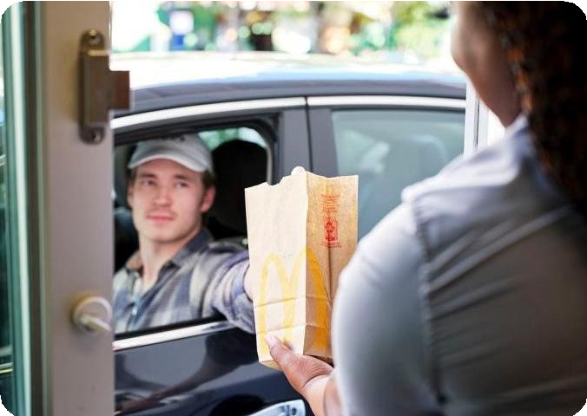

U.S. Segment
Unrivaled drive-thru presence and strong unit economics with a 95% franchised ownership mix*
Average Unit Volumes*
(In millions U.S. $)
% Drive Thru Restaurants*
% Franchised Restaurants
100%
$5.5M
65.2%
65.1%
64.6%
65.2%
64.8%
65.1%
90%
Over 55% of Restaurants
have a Drive Thru
$0M
80%
2019 2020 2021 2022 2023 2024
* As of 12/31/2024

Slide 12






IOM Segment
Powerful brand presence and largely reimaged asset base with an 89% franchised ownership mix*
Restaurants*
FY’24 Revenues
FY’24 Adj. Operating Income**
15%
20%
17%
33%
32%
32%
13%
10%
11%
15%
10%
16%
12%
18%
12%
14%
10%
10%
Australia
Canada
France
Germany
United Kingdom
Other
* As of 12/31/2024
** Adjusted operating income is a non-GAAP financial measure; see “Important Disclaimers”

Slide 13




Evolution of Accelerating the Arches Strategic Plan
Additions of Restaurant Development and Our Platforms
Our Purpose
Feed and foster communities
Our Mission
Making delicious feel-good moments easy for everyone
Our Values
Our Growth Pillars
Maximize our Marketing
🡵 Brand
🡵 Affordability
Commit to the Core
🡵 Burger 🡵 Coffee
🡵 Chicken
Our Platforms
●
Serve ⭢ We put our customers and people first
Consumer
One of the world’s largest consumer platforms to fuel engagement
• Inclusion ⭢ We open our doors to everyone
Restaurant
Easiest and most efficient restaurant operating platform
• Integrity ⭢ We do the right thing
●
Community ⭢ We are good neighbors
Double Down on the 4Ds
Company
Modern company platform that
unlocks speed and innovation
🡵 Delivery
🡵 Digital
🡵 Drive Thru
🡵 Development
●
Family ⭢ We get better together

Slide 14
2024 Global Financial Overview
Strong growth over the last 5 years is a testament to the resilience of the business
Total Revenue Systemwide Sales*
Other Financial Metrics
30
140
$130.7B
Global G&A % of Systemwide Sales* | 2.2%
Global McOpCo Margin | 14.8%
Global Franchised Margin | 83.9%
Franchised Revenue % of Franchised Sales**
US | 14.3%
IOM | 17.2%
IDL& Corp | 5.6%
Free Cash Flow Conversion* | 81.1%
$25.9B
$100.2B
25
120
$21.4B
100
20
80
15
60
10
40
5
20
0
0
2019 2024
+$4.5B
(In 5 Years)
2019 2024
+$30.5B
(In 5 Years)

