Slide 1
Comprehensive Case Analysis and Strategic Intervention Planning
A Structured Approach to Diagnosing Problems, Implementing Solutions, and Evaluating Outcomes
1
Comprehensive Case Analysis and Strategic Intervention Planning

Slide 2

Case Title & Overview (What to expect)
Case Title and Setting
Objective of the Case
Presentation Roadmap
Case title, setting (clinical or business), and presenting role (medical resident or business student)
One-sentence objective: what decision, diagnosis, or improvement this case supports
Roadmap of the presentation sections (profile → challenges → analysis → interventions → plan → outcomes → takeaways)
2
Comprehensive Case Analysis and Strategic Intervention Planning

Slide 3
Patient/Company Profile (Who/what we are working with)
Core identity
Baseline status
Stakeholders & priorities
patient demographics/clinical context or company mission/business model
current health indicators or current performance metrics and constraints
patient needs/caregivers or leadership, customers, regulators, internal teams
3
Comprehensive Case Analysis and Strategic Intervention Planning

Slide 4
Symptoms / Market Challenges (What is going wrong)
Primary Problem Statement
The main symptom cluster or the key market/business pain
Supporting Evidence
Frequency, severity, duration (clinical) or churn, conversion, latency, cost drivers (business)
Impact Mapping
Harms and risks (clinical) or revenue, retention, compliance, operational risk (business)
4
Comprehensive Case Analysis and Strategic Intervention Planning

Slide 5
Diagnostic Process / Analysis (How we explain it)
Hypothesis generation
Data collection & validation
Analytical approach
Synthesis
differential diagnosis or root-cause candidate list
tests/interviews/metrics, and what confirms or refutes hypotheses
frameworks (clinical reasoning or business analytics) and key assumptions
most likely cause(s), evidence strength, and remaining uncertainties
5
Comprehensive Case Analysis and Strategic Intervention Planning

Slide 6
Structured Evidence Tables (Templates you can reuse)
Evidence item | Hypothesis link | Confidence | Notes
Symptom or metric | Cause candidate ID | High/Med/Low | Source + timeframe
Test result or KPI trend | Cause candidate ID | High/Med/Low | Method + limitations
6
Comprehensive Case Analysis and Strategic Intervention Planning

Slide 7
Proposed Solutions / Interventions (What we will do)
Intervention Set
Clinical/Business Rationale
Expected Effect
2–4 options grouped by mechanism (clinical pathway or business levers)
Why each intervention targets the most likely cause(s)
Anticipated changes in outcomes and how success will be measured
7
Comprehensive Case Analysis and Strategic Intervention Planning

Slide 8
Execution Plan (How we deliver safely and on time)
Plan phases
Roles & responsibilities
Operational workflow
Governance
preparation → implementation → monitoring → iteration
owners for clinical tasks or functional workstreams
timeline, dependencies, and escalation triggers
review cadence, quality checks, and stop/continue criteria
8
Comprehensive Case Analysis and Strategic Intervention Planning

Slide 9
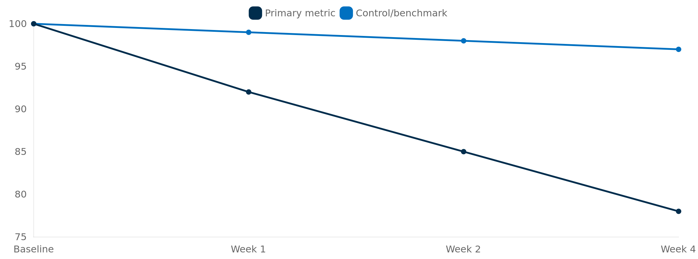
Outcomes / Results (What changed and why)
9
Comprehensive Case Analysis and Strategic Intervention Planning

Slide 10
Visualization Toolkit (Clear placeholders for senior peers)
Visualization placeholder set
KPI dashboard placeholder
Clinical-style pathway placeholder
waterfall (contribution)
funnel (conversion)
risk heatmap (severity × likelihood)
top 5 metrics with definitions
targets
measurement cadence
symptom → tests → diagnosis → intervention → endpoint diagram
10
Comprehensive Case Analysis and Strategic Intervention Planning

Slide 11
Key Takeaways (What seniors should remember)
Most likely root cause(s) and the single best piece of evidence supporting them
Intervention(s) chosen, with the measurable outcomes they are expected to improve
Execution lessons: what worked, what to monitor, and what would change next time
Most likely root cause(s) and the single best piece of evidence supporting them
Intervention(s) chosen, with the measurable outcomes they are expected to improve
Execution lessons: what worked, what to monitor, and what would change next time
11
Comprehensive Case Analysis and Strategic Intervention Planning

