Slide 1



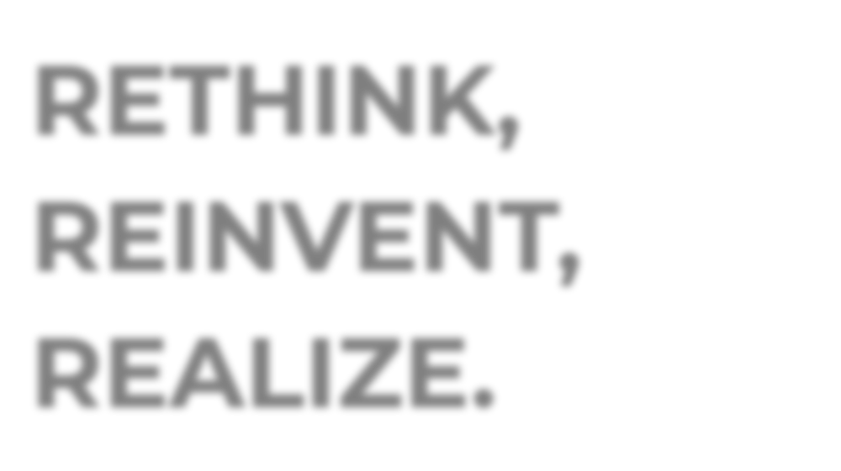




RETHINK, REINVENT, REALIZE.
How to successfully scale digital innovation to drive growth
AUTOMOTIVE - EOS
INTO THE NEW

Slide 2





THE IDEA: FIND INDUSTRY X.O BEST PRACTICES!
OUR PREMISE AND RESEARCH QUESTION
When it comes to digital transformation, scaling innovation pilots is critical. Yet many clients tell us that they are struggling with this very step – and feel that they might get stuck with “piecemeal projects” that don’t deliver significant value.
Can we find key best practices that could help them overcome their challenges, and drive real change, for real new growth?

Slide 3















GLOBAL SURVEY AT-A-GLANCE
AUTOMOTIVE – OES AT-A-GLANCE
n=1,350 responses from companies with 1bn+ in revenue
n=108 responses from companies with 1bn+ in revenue
60% C-suite respondents
57% C-suite respondents
13 industries and 17 countries
13 countries

Slide 4



THE RESULT: IT’S ALL A MATTER OF MANAGEMENT!
OUR KEY FINDINGS
Companies are scaling more than 60 percent of all digital PoCs, but less than two out of ten companies are doing it successfully.
A SURPRISE!
(we didn‘t expect to find that many companies trying to scale!)
What’s the difference? The leading 15 percent manage their scaling efforts differently.
Following the four best practices of these “Champions” is a recipe to succeed at innovating for digital transformation.
THE REASON TO READ!
(these best practices are what readers will come for)
Copyright © 2025
Source: Accenture 2019 Industry X.0 Survey
4

Slide 5






_{Q:} WHAT’S THE CURRENT STATUS IN SCALING
DIGITAL INNOVATION?
THINGS ARE SPEEDING UP –IN SURPRISING WAYS.
A:
Copyright © 2025
5

Slide 6

DESIGN AND PRODUCTION AND OPERATIONS ARE INNOVATION PRIORITIES FOR AUTO–OES COMPANIES
Design is an obvious innovation priority as they focus deeply on product quality and features. Production & Operations is a close second due to the emphasis on streamlined manufacturing operations and rapid turnaround.
*INNOVATION PRIORITY
32.2%
25.0%
21.4%
16.7%
17.5%
15.7%
15.7%
14.5%
11.1%
12.1%
9.5%
5.6%
Product & Service Design
Production & Operations
Supply Chain & Logistics
Automotive - OES
Sales & Aftersales Service
Cross-Industry
Digital/Physical Security
Continuous Customer Engagement
* “innovation priority” = percentage of respondents who are prioritizing digital innovation in these business areas
Source: Accenture 2019 Industry X.0 Survey

Slide 7

AUTOMOTIVE – OES COMPANIES ARE SCALING DIGITAL POCs ACROSS BUSINESS FUNCTIONS
Automotive – OES manufacturers are almost evenly scaling digital POCs across key business areas
SCALING INTENSITY*
62.0% _{59.8%}
63.0% 63.8%
61.1%
60.8%
58.8% _{58.4%}
59.2%
59.5% _{58.7%}
59.0%
Product & Service Design
Production & Operations
Supply Chain & Logistics
Sales & Aftersales Service
Digital/Physical Security
Continuous Customer Engagement
Automotive - OES
Cross-Industry
* “scaling intensity” = ratio of avg. number of proof of concepts scaled to avg. number initiated in each business function, across discrete and process industries.
Source: Accenture 2019 Industry X.0 Survey

Slide 8




















AUTOMOTIVE – OES COMPANIES RECOGNIZE THE NEED FOR INNOVATING AT SCALE TO:
Operate at speed with an innovative and robust supply chain, and
Continuously deliver reliable and connected products to the customers.
Copyright © 2025
8

Slide 9

ANOMALY DETECTION AND PURCHASE ORDER MANAGEMENT ARE KEY OUTCOMES…
Top 10 outcomes targeted by Automotive – OES companies through scaling of digital PoCs
Automated systems anomaly detection
36%
Digitized purchase order management
36%
Higher growth in service revenues
35%
Lower number of prototype iterations
35%
Improved data privacy
34%
Higher customer satisfaction score
33%
33%
33%
Improved supply chain efficiencies
Reduction in process complexity
Reduced conversion costs (direct labor costs + manufacturing overheads)
32%
Grater plant flexibility
32%
% of respondents who achieved this outcome
Source: Accenture 2019 Industry X.0 Survey
10

Slide 10





…AND THEY ARE CHOOSING BIG DATA ANALYTICS, AR/VR & CLOUD TO DRIVE THESE OUTCOMES
Top 3 technologies leveraged to facilitate scaling, by function
 | PRODUCT & SERVICE DESIGN | PRODUCTION & OPERATIONS | SUPPLY CHAIN & LOGISTICS | SALES & AFTERSALES SERVICE | DIGITAL/ PHYSICAL SECURITY | CONTINUOUS CUSTOMER ENGAGEMENT
AI/AI-powered Automation |  | RANK 1
AI Assistants
3D printing
Mobility
IIOT Sensors & Transmitters
Immersive Experience |  |  | RANK 3 |  |  | RANK 1
Industrial Robotics
Big Data Analytics |  | RANK 3 |  | RANK 1 | RANK 2 | RANK 2
Digital Twin
Cloud | RANK 1 |  |  |  |  | RANK 3
Blockchain |  |  |  | RANK 2 | RANK 3
Autonomous Vehicles | RANK 3 |  | RANK 1
Machine Learning/Deep Learning | RANK 2 |  | RANK 2
Quantum Computing |  |  |  | RANK 3
Cyber Security Protocols |  | RANK 2 |  |  | RANK 1
Source: Accenture 2019 Industry X.0 Survey
10

Slide 11



_{Q:} WHAT ABOUT SCALING SUCCESS –DOES
EVERYONE SEE IT?
NO. SOME COMPANIES RACE AHEAD, OTHERS STRUGGLE.
A:
Copyright © 2025
11

Slide 12


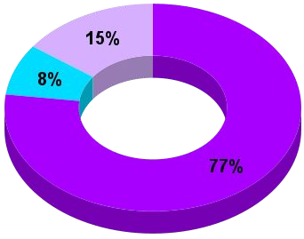
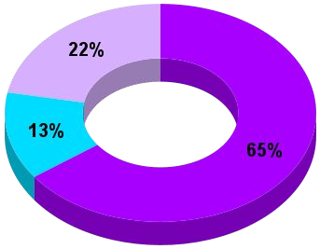





SO, WHO’S SCALING THE BEST?
The Automotive – OES industry has a lower percentage of Champions compared to the global average
AUTOMOTIVE - OES CROSS-INDUSTRY
CHAMPIONS
Earn RODI higher than industry ROIC and industry RODI; scale more than 50% of their digital Proof-of-Concepts
CONTENDERS
Earn RODI lower than industry ROIC and lower than industry RODI; scale more than 50% of their PoCs
CADETS
Earn RODI lower than industry ROIC and lower than industry RODI; scale less than 50% of their PoCs
*Percentage of champions in each geography = 100 x (The number of champions in a particular geography)/(Total number of companies surveyed in that particular geography)
**Percentage of champions in each industry = 100 x (The number of champions in a particular industry)/(Total number of companies surveyed in that particular industry)
Source: Accenture 2019 Industry X.0 Survey

Slide 13

























AUTO-OESCHAMPIONS SET THEMSELVES HIGHER “RODI” TARGETS AND ACHIEVE THEM TOO.
Automotive – OES Champions achieved over 4 times the RODI clocked by Contenders; proving that its not how much you scale, but how you scale that matters
Returns on Digital Investment (RODI)
RODI = Returns on Investment (Net Gain/Total Investment) from scaled digital PoCs across all the key business functions. We asked executives about the average RODI they expected before scaling digital PoCs, and the RODI they finally achieved.
AUTOMOTIVE - OES
CROSS-INDUSTRY
25,5% RODI expected
22,5% RODI expected
CHAMPION
27,1% RODI achieved
25,4% RODI achieved
7,4% RODI expected
7,1% RODI expected
CONTENDERS
6,5% RODI achieved
6,4% RODI achieved
6,1% RODI expected
11,4% RODI expected
CADETS
4,7% RODI achieved
9,7% RODI achieved
Source: Accenture 2019 Industry X.0 Survey

